Slide 1
Blessed ANTONIO ROSMINI
THE FIVE WOUNDS OF THE
HOLY CHURCH

Slide 2
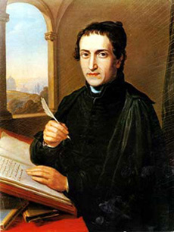
It is undoubtedly the most famous of Rosmini’s books, written with great passion and love for the Church. It caused him immense personal damage, but he felt that the renewal of the Church was of such great urgency that he had to be prepared to suffer for it. Rosmini borrowed the image of the “crucified Church” from Pope Innocent IV (1243-1254), Fr Bonaventura da Recanati (XVI – XVII century, preacher of Clement XI and Innocent X), Pope Gregory XVI (contemporary to Rosmini and his friend, in the letter “Mirari vos” 1832).
Rosmini wrote it in 1832, but did not publish it, “the time did not seem ripe”. In 1846, a new Pope was elected, Pius IX “who seems destined to renew our age and give the Church the impetus for a new, glorious stage of unimaginable development”.
Rosmini published it in 1848 for a circle of friends “who have shared my sorrow, and now look forward with me in hope”.
Unfortunately, it was so successful that many printing firms published it in many cities in Italy and in Europe, without permission from the author. It had a brief life: it was condemned by the Church and placed in the Index of Forbidden Books in 1849, barely one year after its first publication.

Slide 3
SOME QUESTIONS …
Why would Rosmini write the book?
Why did he write it then and why did he publish it afterward?
Why would he use the expression «wounds»?
Which kind of spirituality is in it?

Slide 4
With hind-sight we can say that the publication of the book in 1848 was a great mistake, given the agitated political situation in most of Europe. It was bound to raise fierce opposition from all quarters, but especially from the Austrian Government.
Austria, who was occupying most of North Italy, viewed Rosmini as “our most formidable enemy” and “the evil genie of Pius IX” (from a letter of the Austrian Ambassador in Rome, 1849). Rosmini was a subject of the Austrian Empire (Rovereto was under Austria at that time), but he did not hide his strong desire for the independence of Italy as a confederation of free Italian states.

Slide 5
Why?
The French Revolution (1789)
Freedom – Equality Fraternity

Slide 6
Louis XIV 1638 – 1715 L'état, c'est moi. The absolute monarchy by divine right.

Slide 7
Card. Richelieu 1585 - 1642

Slide 8
Luigi XVI 1754 – 1793

Slide 9
Maximilien de Robespierre 1758 – 1794 35.000 – 40.000 people executed

Slide 10
Napoleon Bonaparte 1769 - 1821

Slide 11
Pius VII 1742 – 1823 Imprisoned in Italy and in France by Napolion from 1809 to 1814

Slide 12
The Congress of Vienna 1814 The Restauration
This period goes from 1814-1815 up to 1831.
Promoted by Francis II of Ausburg Lorena Imperor of Austria
Together with England, Prussia and Russia
The illusion is to bring everithing back as it was before 1789
In France the new King should be Louis XVIII (younger brother of Luois XVI)
In 1831 there’s a new Revolution in France. End of an Illusion …

Slide 13
Italy at Rosmini’s time

Slide 14
1831 Revolution in France and Condemnation of the writes of Felicité de Lamennais
The priest Felicité de Lamennais founded a newspaper called L’avenier
In favour of introducing democracy in the Church
The «Statutes» should be given
Here comes Pius the IX, inicially in favour of the «Statutes»

Slide 15
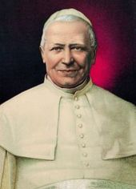
Why to write in 1832 and publish in 1848?
Two important Popes
Gregory XVI
St. Pius IX

Slide 16
Why wounds? Which Spirituality?
The letter «Mirari vos»
The «Statutes»
Rosmini and:
St. Catherine of Siena
St. Philippe Neri
The Camaldolese «Libellus ad Leonem» (Leo X)
St. Augustin and Fr. Muratori (the «consistency»)
Capucin spirituality (Fr. Bonaventura da Recanati)

Slide 17
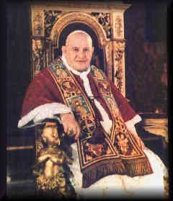
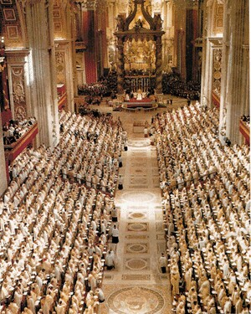
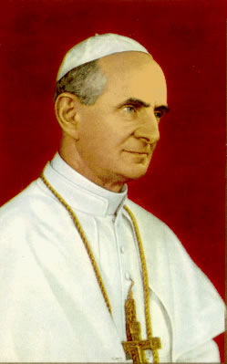
St. Pius IX had already rehabilitated the book with the “Dimittantur” decree in 1854, but it was definitely taken out of the Index in 2001 with all the other works of Rosmini. It was anyway known to the Bishops who took part in it, and many of the ideas of the book found their way in the Documents of Vatican II.
Fr. Clemente Riva, future Bishop, Rosminian, republished it in 1966. Translated in 10 to 12 different languages. It still is the most famous work of Rosmini in the world.
Pope Paul VI called the Five Wounds of Holy Church “a prophetic book”. It is the opinion of many that some of the Wounds are still waiting for a cure, and we may need perhaps a Vatican III to tackle more resolutely the Third, Fourth, and Fifth Wounds; and even the First and Second Wounds are still very much open, although the Church of Vatican II has produced important documents towards “healing” them.
Pope Francis quotes it in “Veritatis Gaudium” 4c.

Slide 18
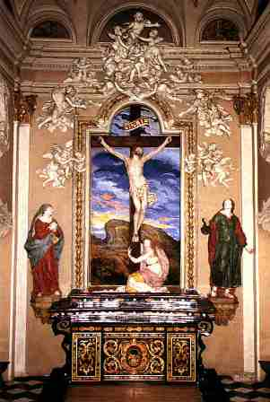
The Five Wounds of the Church
The division between people and clergy at worship. LETF HAND
The insufficient education of the clergy. RIGHT HAND
Disunion amongst the Bishops. SIDE
The nomination of Bishops in the hands of civil government. RIGHT FOOT
The enslavement of Church’s goods (by the State and by the lack of poverty of the members of the Church). LEFT FOOT

Slide 19
Rosmini’s Introduction Out of zeal for the good of the Church and for the glory of God
I began to write this book when stayin at a country house near Padua. It was intended as a release for my own interior sorrow, and perhaps as a comfort for others.
At first I esitated: «Would it be right for an ordinary person like me to make a study of the ills of holy Church?»
But no fault can be found even in an ordinary person like myself if he considers the ills of the Church out of zeal for her good and for the glory of God. And as far as I could see, I had non other motive

Slide 20
Thoughts that have to be submitted to the Pastors of the Church
In setting out my thoughts on the subject, I wanted to submit them to the pastors themselves, especially the Pope, whose decisions will always be the sure criterion by which to balance and correct all my opinions.
The pastors of the Church do not always have the opportunity of quiet thought in the midst of their administrative occupations; they themselves want others to offer reflections which may help in the government o their particular churches and of the universal Church.

Slide 21
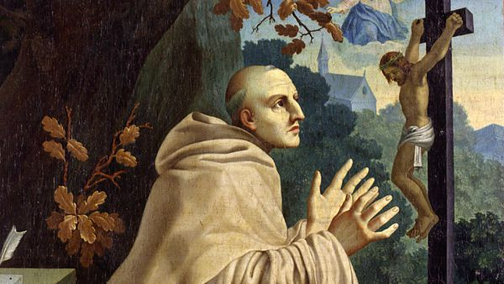
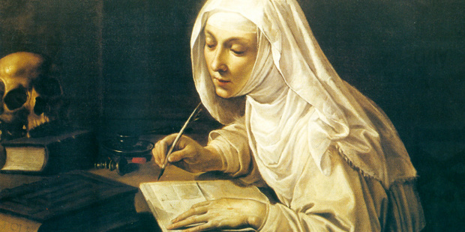
Following the example of Holy Men and Women
I pondered the example of those holy people found in every age of the Church who, without being Bishops, spoke and wrote with admirable freedom and directness about the evils afflicting the Church of their times, and about the need and the manner of restoring her
St. Jerome
St. Bernard
St. Catherine

Slide 22
I write concious that I might get in trouble A duty of concience
I realized that all modern writers on these subjects had fallen foul equally of both Church and state despite their declared intention of following a mean between the two extremes and satisfying both.
However I was not looking for human approval, nor worldly advantage.
If individuals on both sides objected to what I had to say I could fall back on the witness of my conscience and await the Judgment against which there is no appeal.

Slide 23
What could upset men of state …
From the point of view of the State, there was only one reason for dissatisfaction, that is, my inability to approve of leaving the nomination of bishops in the hands of the secular power.
In rejecting such a privilege considered in itself, I was convinced that it was as harmful to the state as to the Church, and a grave political error to believe the contrary.

Slide 24
What could upset men of Church …
From the Church’s point of view, there seemed no possibility for dissatisfaction except perhaps for what the book contains about the exaggerations of papar reservations.
I had therefore every reason for believing that the work would not displease the Holy See, to whose judgment I intend to submit everything I do.
I have always recognised the view of the Holy see as noble, dignified and completely in harmony with truth and justice, and its dogmatic decisions as incapable of error.

Slide 25
An encouraging example: Consilium de emendanda Ecclesia
Pope Paul III (1468 –1549)
Pope from 1534 to his death in 1549.
He came to the papal throne in an era following the sach of Rome in 1527
He rife with uncertainties in the Catholic Church following the Protestant Reformation
During his pontificate, and in the spirit of the Counter Reformation, new Catholic religious orders and societies, such as
the Jesuits,
the Barnabites
the Congregation of the Oratory
All this attracted a popular following.
He convened the Council of Trent in 1545.

Slide 26
A courageous text out of love for the Church
31 October 1517 Luther nails a document of protest with 95 point on Wittenberg Cathedral’s doors. It’s the beginning of the Protestant Reformation and schism.
In 1536 Pius III appointed a Commission of Cardinals in order to give him a report about the moral state of the Church in the light of the Reformation. They were not afraid to point out to the Pope himself the evil that so much was damaging the Church, and in it the Pope’s tendency towards nepotism.
The respons, «Consilium de emendanda Ecclesia», comes in 1537 and it’s hard: «Holy Father, the source of so many abuses and grave evils in the Church of God lies here. Like a Trojan horse, it has poured its appaling host into the Church, burdening and challenging it. Knowledge of such shame is current even amongst unbelievers who as a result mock the Christian Religion. Is is through us that the name o Christ is blasphemed among the nations».

Slide 27
A spirit of Reformation inside the Church
The movement of the so called Counter Reformation goes on up to Rosmini’s time.
It grows INSIDE THE CHURCH
It’s guided by the COMMUNION WITH POPE AND BISHOPS
It starts from a PERSONAL CONVERSION OF PEOPLE
It’s at the core of the two Rosminian principles
First, to apply ourselves to correct our faults and purify our soul by prayer and living a life as close to the teaching of Christ as possible.
Second, to accept any opportunity to do charitable work.

Slide 28
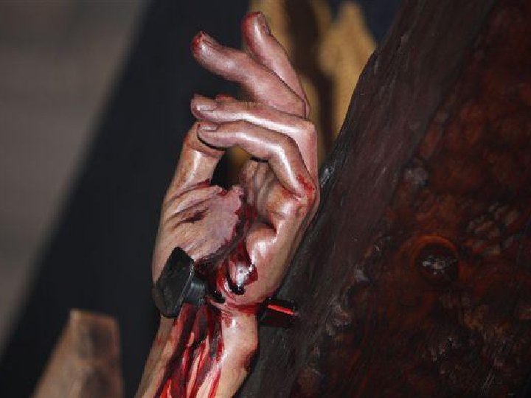
The First Wound:
The Wound in the left hand of holy Church: the division between people and clergy at public worship.
Rosmini had a very lofty view of the dignity of the laity. The “faithful”, for Rosmini, are the clergy and the laity together, representing and forming in the Church the marvellous unity indicated by Christ when He said,
“Where two or three are gathered in my name, in agreement about everything they ask, there I am in their midst”.
Christ demands unity of minds and hearts, the clergy and the people acting together “as one man” as Scripture says of the ancient Israelites.

Slide 29
ONE IN BODY BY PARTAKING OF THE BODY OF CHRIST
LUMEN GENTIUM
7. In the human nature united to Himself the Son of God, by overcoming death through His own death and resurrection, redeemed man and re-molded him into a new creation.
By communicating His Spirit, Christ made His brothers, called together from all nations, mystically the components of His own Body.
In that Body the life of Christ is poured into the believers who, through the sacraments, are united in a hidden and real way to Christ who suffered and was glorified.
Through Baptism we are formed in the likeness of Christ: "For in one Spirit we were all baptized into one body".
Really partaking of the body of the Lord in the breaking of the Eucharistic bread, we are taken up into communion with Him and with one another. "Because the bread is one, we though many, are one body, all of us who partake of the one bread". In this way all of us are made members of His Body, "but severally members one of another".

Slide 30
THE LIVING BODY OF CHRIST SOURCE OF OUR SALVATION
SACROSANCTUM CONCILIUM
5. God
Who "wills that all men be saved and come to the knowledge of the truth" (1 Tim. 2:4),
"who in many and various ways spoke in times past to the fathers by the prophets" (Heb. 1:1),
when the fullness of time had come sent His Son, the Word made flesh, anointed by the Holy Spirit, to preach the the gospel to the poor, to heal the contrite of heart, to be a "bodily and spiritual medicine", the Mediator between God and man.
His humanity, united with the person of the Word, was the instrument of our salvation. Therefore in Christ "the perfect achievement of our reconciliation came forth, and the fullness of divine worship was given to us"

Slide 31
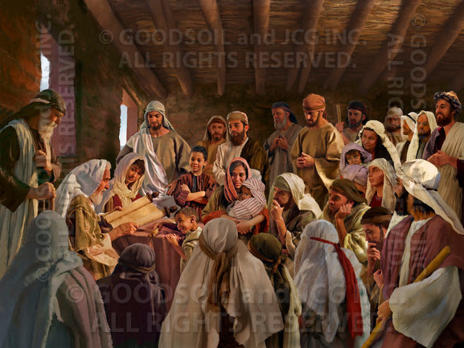
IN ORDER TO BE SAVED WE NEED TO ACT AS ONE BODY
The early Christians, Apostles and believers, were “one in heart and mind”, they acted as one Body:
They believed the same truths,
They took part fully, body and soul, in their liturgies, the Eucharist and the Sacraments.
They understood what was being said and done.

Slide 32
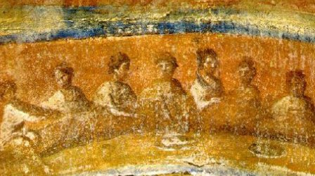
IN ORDER TO ACT AS BODY OF CHRIST IT IS NOT ENOUGH TO LEARN A NEW DOCTRINE
Jesus came to save the whole person, body and spirit.
The Gospel had to appeal to both elements of the human nature, to the mind and to the heart. The Apostles were indeed sent out to “preach”, to instruct people, and to baptize.
But they did not found a school of philosophy, nor did they perform miracles simply to prove the truth of what they were saying, nor gave examples of great virtues to persuade their listeners.
If they had presented Christianity simply as wisdom, as truths to be believed, they would not have achieved much. Their appeal would have been greatly reduced.
Christianity is not a philosophy, a set of doctrines, a matter for the mind only. There is much more to it. As a purely intellectual system it would have perished long ago!

Slide 33
IN ORDER TO ACT AS BODY OF CHRIST IT IS NOT ENOUGH TO CULTIVATE HUMAN VIRTUES
The Apostles did indeed reveal to corrupt mankind all the virtues they themselves had seen in their divine Master and imitated.
But their virtue had been oppressed and suffocated in mankind by idolatry and fictitious needs of evil.
There could be no approval of their virtues at the deepest level of human nature because that depth had become an abyss, guarded by the Cerberus of human perversity, into which light could not penetrate.
Virtue of the Lord’s Apostoles was repaid by the cruel ferocity of the sons of men who tore them to pieces and delighted in shredding their blood.
WHAT COULD
SAVE HUMANITY THEN ?

Slide 34
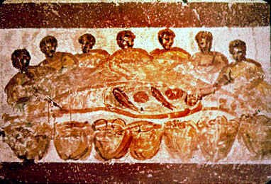
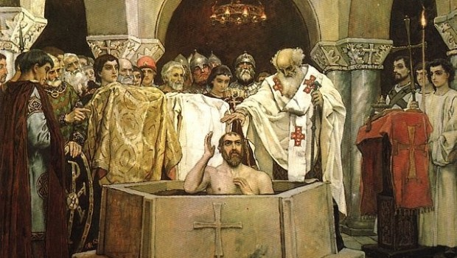
IN THE SACRAMENTS A NEW CREATION TAKES PLACE
Jesus’ command was, “Go out into the whole world and make disciples of all nations, baptising them in the name of the Father, and of the Son, and of the Holy Spirit” (Mt 28,19).
His command was
to enlighten the intellect by the way of preaching,
to regenerate the will, by the work of Grace,
to “speak” to the feelings by the use of signs
BY “BAPTISING”, BY THE SACRAMENTS, BY THE ACTS OF WORSHIP OF THE NEW TESTAMENT.
“The Sacraments were words and signs of God, creating a new soul, creating new life, new heavens and a new earth. The Apostles added to their preaching Catholic Worship, which consists principally in the Sacrifice of Mass, the Sacraments, and the prayers in which these are expressed”.

Slide 35
Accomplishing the work of Salvation by means of Sacrifice and Sacraments
Sacrosanctum Concilium
6. Just as Christ was sent by the Father, so also He sent the apostles, filled with the Holy Spirit.
This He did that, by preaching the gospel to every creature (Mk 16,15), they might proclaim that the Son of God, by His death and resurrection, had freed us from the power of Satan (Acts 26,18) and from death, and brought us into the kingdom of His Father.
His purpose also was that they might accomplish the work of salvation which they had proclaimed, by means of sacrifice and sacraments, around which the entire liturgical life revolves.

Slide 36
IN SACRAMENTAL WORSHIP ThROUGH EXTERNAL ACTIONS GRACE IS BESTOWED UPON US
When the author of mankind decided to reform human nature, he was not satisfied with proclaiming moral precepts to the understanding; he also bestowed upon the will the practical strenght to carry them out.
He united this strenght to external rites to show that he was giving it to men and women freely, and could condition it as he wished.
These rites were also Sacraments, that is, signs, because they were to save, and communicate life and salvation through fitting signs and words.

Slide 37
EVERY LITYRGICAL ACTION HAS A MEANING. Importance of understanding the meaning of what we do.
Grace, which strengthens the will, il communicated through the understanding.
It is an intellectual feeling enabling a chirstian to sense his God, live on this sense,and be vigorous in action.
The Apostles and their successors followed the example of their Master, added to the celebrations prayers and rites in order to help the full accomplishment of worship for the glory of God and for the good of the faithful.
Everything said and done had to signify sublime and divine truths.
Nothing had to be shadowy and mute in the act of worship in which the Being enlightens the understanding of intellective creatures.
Divine intelligence leaves its mark when it receives rational worship, and of itself penetrates and enlivens rational natures.

Slide 38
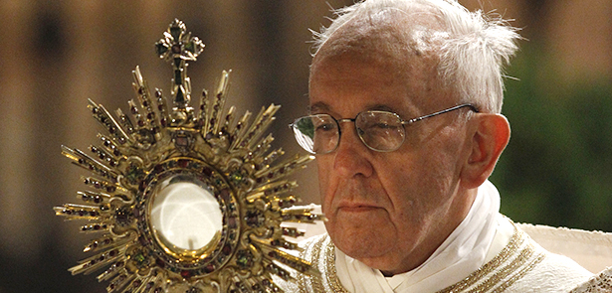
TWO FOUNDAMENTAL ELEMENTS OF CHRISTIAN WORSHIP:
WORDS AND ACTIONS WITH THEIR PROPER MEANINGS
There is great divine power at work through Mass, Baptism, Marriage, Confession, and the other Sacraments. The divine power is manifested through the words which are said and through the actions which are done. The words speak to the mind, the actions move the heart.
Early Christians understood the words and knew the meaning of every gesture during worship. The priest and the people were truly one in what they said and in what they did.
Because the Gospel was intended to save all mankind, it had both to act on the elements which make up human nature, and accompany it with its divine action in all its developments.
It needed to support mankind in all its possible states so that human nature’s bias or tendency to evil might not plunge it to destruction.

Slide 39
GENUINE PARTICIPATION OF PEOPLE IN LITURGICAL ACTION
Worship, to which God united the grace to render men and women capable of practising the moral precepts they had received, was not simply a spectacle for the people to behold.
The people were not to be present simply to look at what was happening without genuinely participating in this drama of religious worship.
The people in God’s temple were themselves to be an important element in worship.
The sublime worship of holy Church is thus a single action of clergy and people together, the result of orderly, reasonable accord working to bring about a single combined homage.

Slide 40
ACTIVE PARTICIPATION IN SACROSANCTUM CONCILIUM
14. Mother Church earnestly desires that all the faithful should be led to that fully conscious, and active participation in liturgical celebrations which is demanded by the very nature of the liturgy. Such participation by the Christian people as "a chosen race, a royal priesthood, a holy nation, a redeemed people (1 Pet. 2:9; cf. 2:4-5), is their right and duty by reason of their baptism.
In the restoration and promotion of the sacred liturgy, this full and active participation by all the people is the aim to be considered before all else; for it is the primary and indispensable source from which the faithful are to derive the true Christian spirit; and therefore pastors of souls must zealously strive to achieve it, by means of the necessary instruction, in all their pastoral work.

Slide 41
MEANING OF ACTIVE PARTICIPATION J. Ratzinger The spirit of liturgy.
The real action in liturgy in which we are all supposed to participate is the action o God himself. He inaugurates the new creation. But how can we have a part in this action? We can precisely because God himself has become man, body, and here, again, he comes through his body to us who live in the body
The Sacrifice of the Son is accepted already and forever, but we must still pray for it to become our sacrifice.
In this real action, in this prayerful approach to participation, there is no diference between priests and laity.
God himself is acting and we are drawn into that action of God.
Much more is required of the body than carrying objects around and other such activities. A demand is made on the body in all its involvement int the circumstances of everyday life.

Slide 42
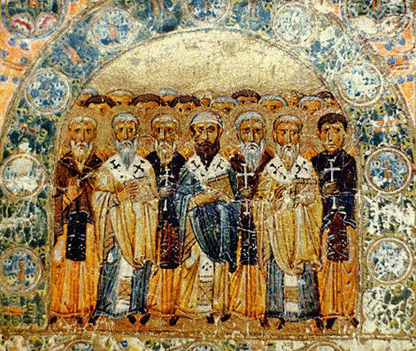
NECESSARY FORMATION OF THE PEOPLE OF GOD.
NEED TO UNDERSTAND THE MEANING OF WORDS AND ACTIONS.
Early Christians KNEW their faith, and understood the various “rituals” or actions at worship.
Yet, most of them, had no great learning, they came from ordinary Roman/Greek/Jewish households. How did they manage to know the deep theology of their faith?
We are amazed at the depth and difficulty of St. Paul’s letters: yet, he wrote them not to confuse his Christians. He knew that they would understand what he was writing because they had been instructed by him and by the others with him.
Early Christians had a real passion for biblical and theological knowledge, communicated to them by their leaders.
People are in harmony and perfectly united when Christians in God’s temple carry out divine service generally speaking with one accord through understanding of their own role and through their realisation of what is being done in church.

Slide 43
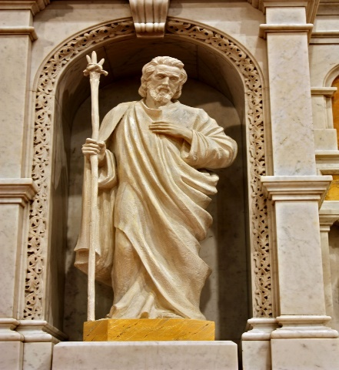
FULL PARTICIPATION IN LITURGY IS A SORCE OF UNITY AND HARMONY
AMONG THE MEMBERS OF THE BODY OF CHRIST
The first wound of the Church is precisely the NON-PARTICIPATION of the faithful, the lack of understanding of what is going on during the great celebrations of the SACRAMENTS, especially of the MASS. The faithful, instead of being totally immersed in what is going on, are like “statues”, present but cold, with no real interest and understanding. The priest is getting on with what he has to say and do, the people do their own things, with their minds elsewhere, perhaps saying their own private prayers.
Through a full participation fervour, appreciation, reverence and devotion increase at worship, and above all the people are united to the clergy through better understanding of the clergy’s true dignity. Love grows between clergy and people, and amongst the faithful making up the people, through unanimity of holy desires and religious feeling.
Communication in spirit allows all to feel truly united in one heart and soul as the family of God the Father
This in turn contributes very effectively to the diffusion in the hearts of the faithful of the very Spirit who prays and beseeches the Father with sighs too deep for words.
Such unity helps to keep the Christian people warmly attached to their teachers in Christ, and submissive and obedient to the clergy whose duty it is to direct them in the way of salvation.

Slide 44
TWO PRINCIPAL REASONS FOR THE DIVISION OF THE BODY OF CHRIST IN WORSHIP
Lack of formation of the people of God about the contents of our faith.
Lack of understanding of the literal meaning of the words spoken in an unknown language.

Slide 45
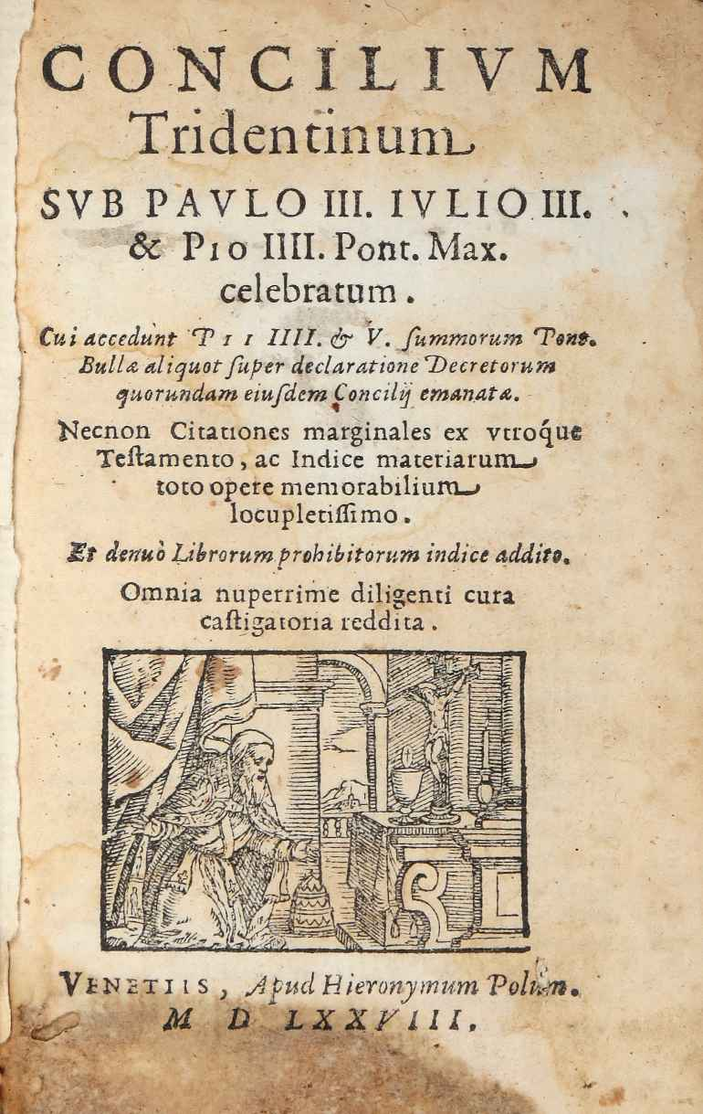
THE IGNORANCE OF THE FAITHFUL IN MATTERS
OF FAITH, SCRIPTURE AND DOCTRINE
The ignorance of the faithful in matters of faith, Scripture, and doctrine is a serious obstacle to a true participation of the faithful in liturgy.
How can people participate in the Sacraments without a sound knowledge of the theology, the words, and the signs used in the administration of the Sacraments, and of Mass in particular?
Early Christians were eager to learn and know more about their faith. It is a well known fact that they managed to irritate the pagans in public places like the baths because they were always arguing about high theological points about the Trinity or about the divine nature or the personhood of JESUS.
The Sacraments are the source of divine power in us, we need them to be transformed by God: but we must try to understand what is being done, and what is being said. We need to know them at a deeper and deeper level to reap all the benefits.

Slide 46
A GOOD CATECHESIS full living instruction
Catechisms are precious because «such coincise formulas are the combined work of the learned of all ages, assisted especially by the presence of the Holy Spirit in the Councils and in the Church scattered throughout the world.
But they are not enough.
A solitary, fixed expression stands immobile and lifeless, and leaves the mind and heart unmoved.
The theacher who repeats by heart what he does not understand may recite exactly what he has learned, but his frozen teaching will chill rather than warm his listeners.
For the majority of people formulas are like dry bread which a baby will only digest after it has been made into pap.

Slide 47
TIME AND PATIENCE FOR A DEEP UNDERSTANDING
Imperfect formulas have a positive side: they allowed the truth to be assimilated by the people of God a little at a time.
But the truth cannot operate in the human spirit if people are satisfied with its dead image.
Real assimilation requires patient explanations so that many different «truths of faith», necessarily divided in order to teach them, can come together and find the unity of Truth in the minds and hearts of people.
Once there, Truth can confirm and complete itself in their lives through the work of the Holy Spirit.

Slide 48
The Homily Benedict XVI Verbum Domini 2010
N. 59
The homily is a means of bringing the scriptural message to life in a way that helps the faithful to realize that God’s word is present and at work in their everyday lives.
It should lead to an understanding of the mystery being celebrated, serve as a summons to mission, and prepare the assembly for the profession of faith, the universal prayer and the Eucharistic liturgy.
Generic and abstract homilies which obscure the directness of God’s word should be avoided, as well as useless digressions which risk drawing greater attention to the preacher than to the heart of the Gospel message.
The faithful should be able to perceive clearly that the preacher has a compelling desire to present Christ, who must stand at the centre of every homily.
For this reason preachers need to be in close and constant contact with the sacred text; they should prepare for the homily by meditation and prayer, so as to preach with conviction and passion.
The synodal assembly asked that the following questions be kept in mind:
“What are the Scriptures being proclaimed saying?
What do they say to me personally?
What should I say to the community in the light of its concrete situation?
The preacher “should be the first to hear the word of God which he proclaims”, since, as Saint Augustine says: “He is undoubtedly barren who preaches outwardly the word of God without hearing it inwardly”. The homily for Sundays and solemnities should be prepared carefully, without neglecting, whenever possible, to offer at weekday Masses cum populo brief and timely reflections which can help the faithful to welcome the word which was proclaimed and to let it bear fruit in their lives.

Slide 49
The Homily Pope Francis Evangelii Gaudium 2013
142. Dialogue is much more than the communication of a truth. It arises from the enjoyment of speaking and it enriches those who express their love for one another through the medium of words. This is an enrichment which does not consist in objects but in persons who share themselves in dialogue. A preaching which would be purely moralistic or doctrinaire, or one which turns into a lecture on biblical exegesis, detracts from this heart-to-heart communication which takes place in the homily and possesses a quasi-sacramental character: “Faith comes from what is heard, and what is heard comes by the preaching of Christ” (Rom 10:17). In the homily, truth goes hand in hand with beauty and goodness. Far from dealing with abstract truths or cold syllogisms, it communicates the beauty of the images used by the Lord to encourage the practise of good. The memory of the faithful, like that of Mary, should overflow with the wondrous things done by God. Their hearts, growing in hope from the joyful and practical exercise of the love which they have received, will sense that each word of Scripture is a gift before it is a demand.
143. The challenge of an inculturated preaching consists in proclaiming a synthesis, not ideas or detached values. Where your synthesis is, there lies your heart. The difference between enlightening people with a synthesis and doing so with detached ideas is like the difference between boredom and heartfelt fervour. The preacher has the wonderful but difficult task of joining loving hearts, the hearts of the Lord and his people. The dialogue between God and his people further strengthens the covenant between them and consolidates the bond of charity. In the course of the homily, the hearts of believers keep silence and allow God to speak. The Lord and his people speak to one another in a thousand ways directly, without intermediaries. But in the homily they want someone to serve as an instrument and to express their feelings in such a way that afterwards, each one may chose how he or she will continue the conversation. The word is essentially a mediator and requires not just the two who dialogue but also an intermediary who presents it for what it is, out of the conviction that “what we preach is not ourselves, but Jesus Christ as Lord, with ourselves as your servants for Jesus’ sake” (2 Cor 4:5).
144. To speak from the heart means that our hearts must not just be on fire, but also enlightened by the fullness of revelation and by the path travelled by God’s word in the heart of the Church and our faithful people throughout history. This Christian identity, as the baptismal embrace which the Father gave us when we were little ones, makes us desire, as prodigal children – and favourite children in Mary – yet another embrace, that of the merciful Father who awaits us in glory. Helping our people to feel that they live in the midst of these two embraces is the difficult but beautiful task of one who preaches the Gospel.

Slide 50
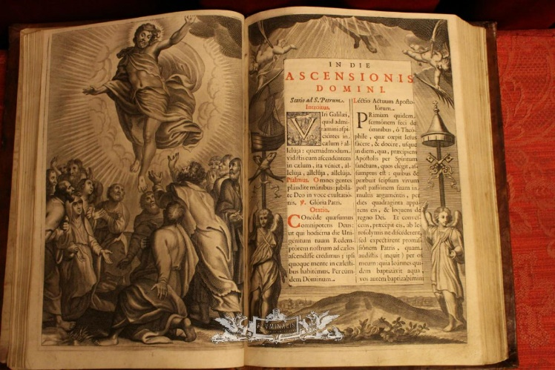
THE USE OF LATIN
At the time of Blessed Rosmini, LATIN was the language of the Mass and of the other Sacraments.
Latin was no longer spoken, it had been a “dead” language for many centuries. Priests understood it because of their training, but ordinary people did not. Hence the division, the non participation.
Yet Rosmini did not call for the abolition of Latin and the use of the vernacular. He argued that modern languages lack the words appropriate for the high mysteries of the liturgy, moreover, they change all the time thus forcing a change of the language every few years, upsetting the people who become familiar with one form.
He believed that the people could be helped to understand the Latin used for religious celebrations, perhaps by training them or by providing them with the Latin and its translation into the vernacular side by side. He himself wrote a booklet on the Mass with the Latin and Italian side by side.

Slide 51
A PROVIDENCIAL INSTRUMENT OF COMMUNION FOR THE EARLY CHURCH: THE ROMAN EMPIRE
Providence prepared the Roman empire in order to overcome obstacles to prompt communication, and Latin was taken almost to the ends of the earth.
The people called to the Gospel possessed a common language enabling them to understand the words
Accompanyng
Explaning
Forming the Sacraments and rites

Slide 52
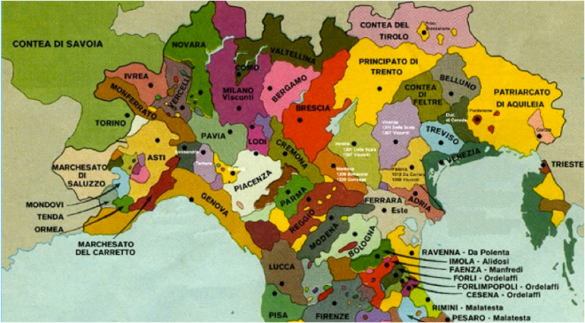
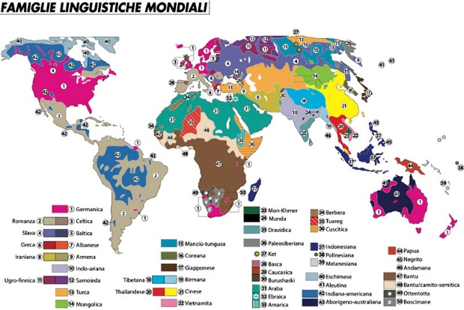
AFTER THE FALL OF THE ROMAN EMPIRE …
But wars and migrations changed languages.
The Church’s tongue ceased to be the language of the people who, as a result of this immense change, found themselves in darkness.
Intellectually, they were cut off from the Church which continued to speak to them, about them and in them.
Like strangers in a foreign land, they were unable to reply to the unintelligible sounds whose meaning they had long forgotten
a

Slide 53
A SURPRISING STATEMENT …
Although we have shown the disadvantage resulting from the people’s inability to understand Latin, we do not think that the liturgy may fittingly be translated into the vernacular.
Latin, Greek and Oriental Churches have consistently retained their liturgies in the ancient languages in which they were written.
Putting the sacred rites into the vernacular would induce problems greater than the remedies imposed.
The principal advantages of ancient languages are:
They reflect the immutability of the Faith
They unite many different Christian peoples in a single rite, and thus impresses more surely the unity and greatness of the Church and its common Brotherhood
They give and other-worldly, superhuman atmosphere through their sense of age and mystery
They offer a solid sense of riassurance to the people who realise that they are praying to God in the same words employed for centuries by holy men and women
They have been adapted by the saints to express fittingly all the divine mysteries

Slide 54
DISADVANTAGES OF THE USE OF VERNACULAR LANGUAGES IN LITURGY
The great number of modern languages would be the cause of severe division amongst the people, and unity and concord would suffer accordingly.
Modern languages are variable and unstable, and that would bring constant changes to the essentially stable character of what is sacred. Such changes could not be given the sufficient continual consideration needed to ensure they were not dangerous to faith itself.
The people wuold be unnerved by these changes and disposed to think that religion varied according to language.
Modern languages would not always have developed sufficiently to express fittingly the entire religious content of the ancient languages formed for this purpose by the spirit of christianity through the work of the saints.
The use of these languages in place of those consecrated by centuries would imply a cure worse than the desease.

Slide 55
Two possible solutions …
If modern languages are excluded only two solutions are at hand.
First, the study of Latin amongst the faithful should be encouraged as much as possible
Second, the christian people should be given a thorough grounding in the meaning of the sacred functions, while the literate faithful need to be introduced habitually to divine services with the help of books containing a translation of the Latin used in church.
But we know that Divine Wisdom assist the catholic Church in her disciplinari rulings as well as in her dogmatic and moral decisions

Slide 56
Rosmini wasn’t a loner on the matter …
The first stirrings of interest in liturgical scholarship (and thence liturgical change) within the Roman Catholic Church arose in 1832, when the French Benedictine abbey at Solesmes was refounded under Dom Prosper Guéranger. For a long time, Benedictines were the pioneers in restoring Roman liturgy to its early medieval form.
At first Guéranger and his contemporaries focused on studying and recovering authentic Gregorian Chant and the liturgical forms of the Middle Ages, which were held to be the ideals. Other scholars, such as Cabrol and Pierre Batiffol, also contributed to the investigation of the origins and history of the liturgy, but practical application of this learning was lacking.
During the 19th century patristic texts were increasingly available and new ones were discovered and published. Jacques Paul Migne published editions of various early theological texts in two massive compilations: Patrologia Latina and Patrologia Graeca.
In addition, the Didache, one of the earliest manuals of Christian morals and practice, was found in 1875 in a library in Constantinople. The Apostolic Tradition, often attributed in the 20th century to the 3rd-century Roman theologian Hippolytus, was published in 1900. This latter was a Church Orders containing the full text of a Eucharistic liturgy; it was to prove highly influential.

Slide 57
VATICAN II AND LITURGY IN VERNACULAR
SACROSANCTUM CONCILIUM 36.
1. Particular law remaining in force, the use of the Latin language is to be preserved in the Latin rites.
2. But since the use of the mother tongue, whether in the Mass, the administration of the sacraments, or other parts of the liturgy, frequently may be of great advantage to the people, the limits of its employment may be extended. This will apply in the first place to the readings and directives, and to some of the prayers and chants, according to the regulations on this matter to be laid down separately in subsequent chapters.
3. These norms being observed, it is for the competent territorial ecclesiastical authority (see n. 22,.2) to decide whether, and to what extent, the vernacular language is to be used; their decrees are to be approved, that is, confirmed, by the Apostolic See. And, whenever it seems to be called for, this authority is to consult with bishops of neighboring regions which have the same language.
4. Translations from the Latin text into the mother tongue intended for use in the liturgy must be approved by the competent territorial ecclesiastical authority mentioned above.
22.2. In virtue of power conceded by the law, the regulation of the liturgy within certain defined limits belongs also to various kinds of competent territorial bodies of bishops legitimately established.

Slide 58
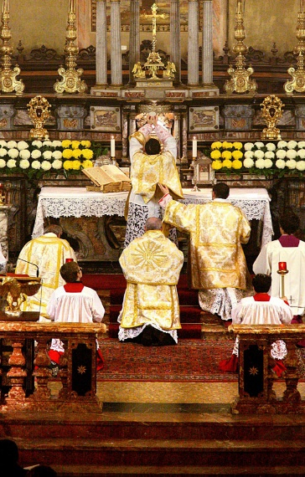
SUMMORUM PONTIFICUM BENEDICT XVI 2007
In some regions, however, not a few of the faithful continued to be attached with such love and affection to the concerned for their pastoral care, through the special Indult Quattuor Abhinc Annearlier liturgical forms which had deeply shaped their culture and spirit, that in 1984 Pope John Paul II, os issued by the Congregation for Divine Worship, granted the faculty of using the Roman Missal published in 1962 by Blessed John XXIII. Again in 1988, John Paul II, with the Motu Proprio Ecclesia Dei, exhorted bishops to make broad and generous use of this faculty on behalf of all the faithful who sought it.
Given the continued requests of these members of the faithful, long deliberated upon by our predecessor John Paul II, and having listened to the views expressed by the Cardinals present at the Consistory of 23 March 2006, upon mature consideration, having invoked the Holy Spirit and with trust in God’s help, by this Apostolic Letter we decree the following:
Art 1. The Roman Missal promulgated by Pope Paul VI is the ordinary expression of the lex orandi (rule of prayer) of the Catholic Church of the Latin rite. The Roman Missal promulgated by Saint Pius V and revised by Blessed John XXIII is nonetheless to be considered an extraordinary expression of the same lex orandi of the Church and duly honoured for its venerable and ancient usage. These two expressions of the Church’s lex orandi will in no way lead to a division in the Church’s lex credendi (rule of faith); for they are two usages of the one Roman rite.
It is therefore permitted to celebrate the Sacrifice of the Mass following the typical edition of the Roman Missal, which was promulgated by Blessed John XXIII in 1962 and never abrogated, as an extraordinary form of the Church’s Liturgy.
There are then very specific conditions to be respected.
The Second Vatican Council expressed the desire that the respect and reverence due to divine worship should be renewed and adapted to the needs of our time. In response to this desire, our predecessor Pope Paul VI in 1970 approved for the Latin Church revised and in part renewed liturgical books; translated into various languages throughout the world, these were willingly received by the bishops as well as by priests and the lay faithful. Pope John Paul II approved the third typical edition of the Roman Missal. In this way the Popes sought to ensure that “this liturgical edifice, so to speak ... reappears in new splendour in its dignity and harmony.”
Pope Francis suppressed the Commission Ecclesia Dei on 17 January 2019 with a new Motu Proprio. Its dutes are now assumed by the Congregation for the Doctine of Faith

Slide 59
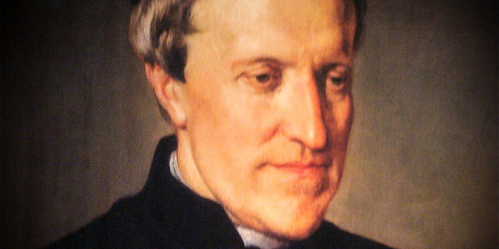
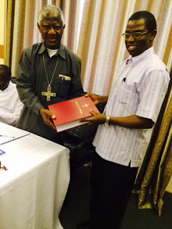
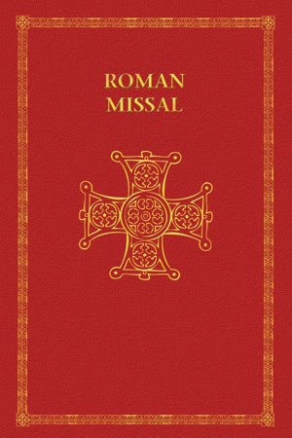
What would Rosmini say today?
It is difficult to know what Rosmini would say about the use of the vernacular in our liturgy.
He would certainly obey, and rejoice for the increased participation of the people.
At the same time his warning about the rapid change of modern languages, the need to revise them constantly and the difficulty of finding suitable “theological” words is still relevant.
Would he be supportive of the Latin Mass today? He would be at one with the Church in allowing the Latin Mass when people ask for it.

Slide 60
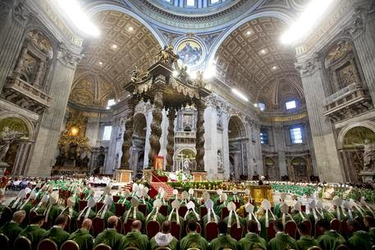
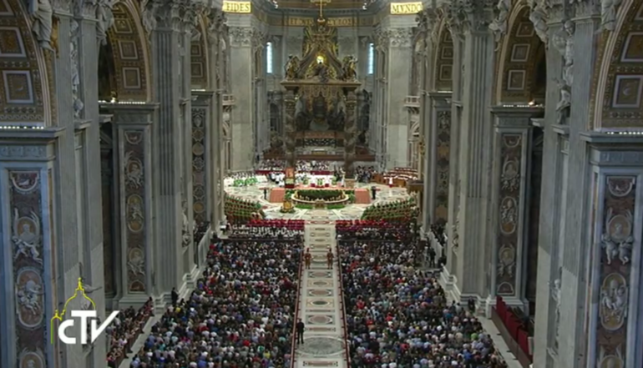
A MISSION FOR THE CATHOLIC CLERGY TODAY
The first wound was deep at the time of Blessed Rosmini, it is also very serious today, notwithstanding Vatican II and the introduction of the vernacular.
Blessed Rosmini recommended the way forward: let the priests educate the faithful, let the people of God know more and understand more of the great events and theology of our salvation.
But he felt that the first wound was the direct result of the second wound of the Church: the insufficient education of the priests and clergy in general. How can the people know if they are not given the means for knowing? And who can give them understanding but the very people who preside over the Sacraments?

Slide 61
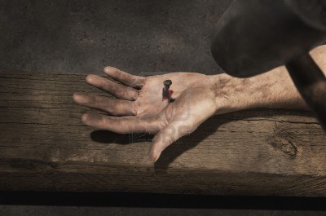
The second wound, the wound in the right hand
The insufficient
education of the clergy
Only great people can form great people!
And great people were in plenty during the first 6 centuries of the life of the Church.
JESUS was the great formator: His disciples learned from Him, and they in turn formed great bishops and priests in the various churches in the east and in the west. Titus, Timothy, Luke, Mark were disciples of St. Paul; St. Irenaeus had been a disciple of St. Polycarp who had been a disciple of St. John, who had been a disciple of JESUS.
Great Bishops formed their priests who later became great Bishops themselves. St Augustine formed a great number of outstanding priests and bishops, and so did St. Athanasius, St. Ignatius, St. John Chrysostom and many others. The house of the bishop was “the seminary” he was their teacher by means of words and the example of a holy and learned life.

Slide 62
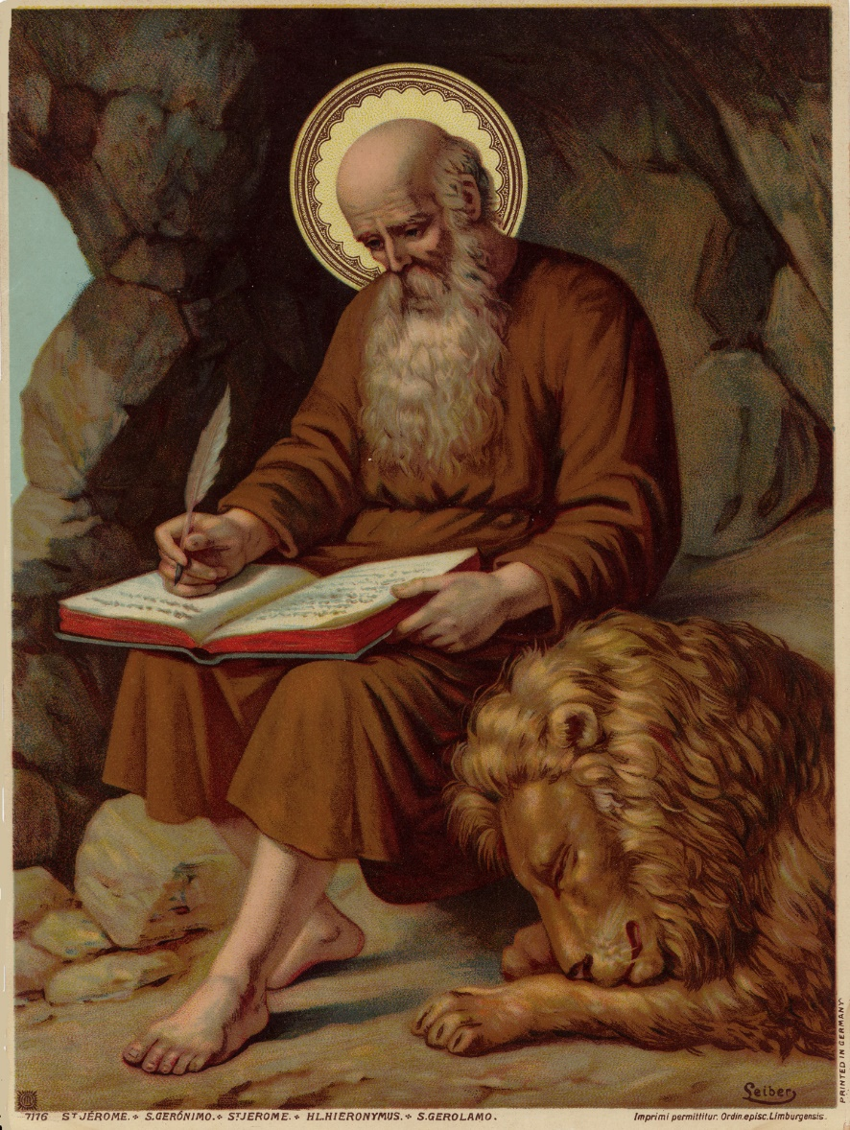
Great Bishops – Strong Communities – Holy Priests
Early bishops and priests were very learned in Scripture and in theological matters. Most of them wrote beautiful commentaries: St. Jerome, St. Augustine, St. Athanasius, Origen, Tertullian, etc. Their knowledge was true wisdom, moving their hearts towards loving God and neighbour. They combined learning with holiness. This is what they passed on to their disciples.
The Christian communities were also strong in the faith, being nourished by holy bishops and priests. JESUS was at the centre of their life, and they knew Him and they loved Him. From such powerful Christian “parishes” there came holy and learned vocations.
Blessed Rosmini claims that our priests are weak or strong according to the communities to which they belong. Weak parishes will produce weak priests, who in turn will lead other parishes in a weak manner. By “weak” we mean very limited in their knowledge and in their faith.
Weak parishes = weak priests = weaker parishes =weaker priests etc.
St Jerome

Slide 63
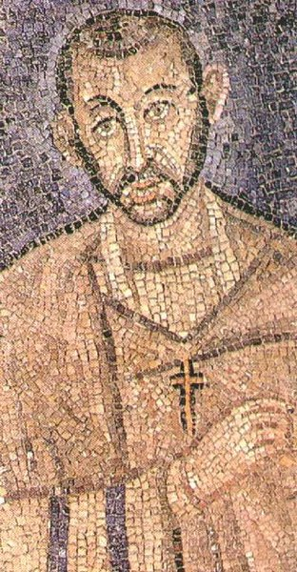
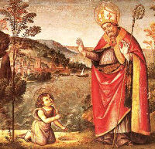
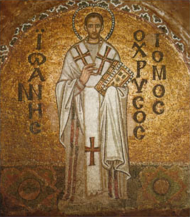
St Augustine
St Ambrose
St John Chrysostom

Slide 64
Saint Ambrose of Milan (340 – 397 AD)
Also known as Aurelius Ambrosius, is one of the four original doctors of the Church. He was the Bishop of Milan and became one of the most important theological figure of the 4th century.
Ambrose was born around 340 AD to a Roman Christian family. He grew up with his siblings, Satyrus and Marcellina, in Trier, Belgic Gaul (present-day Germany).
Educated in Rome, where he studied law, literature and rhetoric. Consular prefect, of Liguria and Emilia around 372 with headquarters in Milan, the then second capital of Italy.
In 374 he became the Bishop of Milan. After the former Bishop of Milan died, Ambrose attended the election to prevent any uproars between the Nicene Church and the Arians. While giving an address, the assembly began calling for him to become the next bishop.
He studied theology with Simplician, a presbyter of Rome. Using his new education, along with his knowledge of Greek, he took the time to study the Old Testament and Greek authors. He used all of this while preaching; his abilities impressed Augustine of Hippo, who previously thought poorly of Christian preachers. In 387, Ambrose baptized Augustine.
Around 386, he opposed the Emperor Valentinian II and his mother, Justine, along with many other people, including clergy, laypersons, and military, who professed Arianism.
After Theodosius I, emperor of the East, married Justine, Ambrose had him excommunicated for the massacre of 7,000 people. The emperor did several months worth of public penance.
Among many others, some of his works
De Officiis Ministrorum
De mysteriis
Homiletic commentaries
A collection of hymns on the Creation of the Universe. (among them probably the Te Deum)
81 letters

Slide 65
St. Augustin of Hippo (354 – 430 AD)
Born in Thagaste, Numidia (Algeria) into an upper-class family and raised in the Christian faith by his holy mother Monica.
Soon Augustine abandoned the Faith and became a Manichean, in a Gnostic, dualistic sect founded in the A.D. 200s by an Iranian man named Mani.
He took a position teaching rhetoric in Milan, Italy and, with the encouragement of his mother, began to have more contact with Christians and Christian literature.
He was instructed by St. Simplicianus and St. Ambrose of Milan baptized him in 387 AD.
In 391, he was ordained a priest of the diocese of Hippo, in 395, he became the city’s coadjutor bishop and then its bishop. As bishop, he wrote extensively, and the value of his writings was such that he became a Church Father.
Died in Hippo while the Vandals were sacking the city.
Some of his writes:
The Confessions (his spiritual autobiography)
The City of God
On Christian Doctrine
Handbook on Faith, Hope, and Love
De Trinitate (on Trinity)

Slide 66
St. Jerome 342-420 AD
He was born around 342 AD, in Stridon, Dalmatia. Today, the town, which ceased to exist in Jerome's time, would likely be in Croatia or Slovenia.
Of rich Christian family, he was educated by Aelius Donatus, who was a famous Roman grammarian. From him, the young Jerome learned Latin and Greek.
Around the age of 12 or so, Jerome traveled to Rome to study grammar, philosophy and rhetoric, and there he had a time of dissolution.
Through the help of his friend Bonosus, in or around the year 366, Jerome decided to become a Christian and was baptized by Pope Liberius.
He studied the Scripture in Trier and Aquileia with Bishop St. Valerian, who had attracted some of the greatest minds in Christendom. Then with a monk, Rufinus, expert in translations from greek into latin.
He went then to Anthioc, where he was ordained priest, and then to Costantinople, at the school of St. Gregory of Nazianzus. He would have retired to de desert as a hermit, but always needs of the Church brough him back to active life.
In 382 he went to Rome and was secretar to the Pope St. Damasus I.
At the death of Pope Damasus, he retired in a monastry in Bethlehem and spent the rest his life translating the scriptures from Hebrew in Old Latin.

Slide 67
St. Gregory the Great (540-604 AD)
Pope Saint Gregory I, also known as the Great, was the Pope of the Catholic Church between 590 and 604 AD.
Descendant of the same rich and noble family of Pope Felix III who reigned from 483 to 492, he wa born in Rome.
Gregory's family was very wealthy and owned estates on the island of Sicily which provided income.
Times were bad: the barbarian Ostrogoths sacked Rome in 546. The Franks attempted an invasion in 554.
He excelled so much in his studies and in his career he became the Prefect of Rome following his father.
After his father had died, Gregory had the family villa in Rome converted into a monastery, today called San Gregorio al Celio, and became a strict monk.
Pope Pelagius II, who reigned from 579 to 590, chose Gregory to serve as an ambassador to the imperial court in Constantinople.
In 590, Pope Pelagius II died, and Gregory was proclaimed pope by acclamation. This was not something Gregory wanted, but he accepted the burden nevertheless. He also referred to himself as a servant of God.
Pope Gregory was famous for the emphasis he put on missionary work and for his liturgical and disciplinary reform of the Church. He established the so called “Gregorian chant”.
Keen on the care of the pour, he established that the clergy themselves go out in the streets and minister to them.
From the time of Gregory onwards, the people looked to the Church for government rather than the distant and indifferent emperors in Constantinople.
Some of his writes
Commentary on Job
Dialogues
Liber regulae pastoralis
Copies of some 854 letters

Slide 68
THE FIRST SEVEN ECUMENICAL COUNCILS
First Council of Nicaea (325 A.D.) Against Arians (The Son is God as the Father).
First Council of Constantinople (381 A.D.) Against Arians and Pneumathochians (The Son and the Holy Spirit are God as the Father).
First Council of Ephesus (431 A.D.) Against Nestorianism (Jesus is Son of God. Mary is Theotokos)
Council of Chalcedon (451 A.D.) Jesus Christ is truly God and truly man.
Second Council of Constantinople (553 A.D.) Again against Nestorianism (Theodore of Mopsuestia and other writers)
Third Council of Constantinople (680-681 A.D.) Against Monothelitism and Monoenergism (Patriarch Sergius I of Constantinople).
Second Council of Nicaea (787 A.D.) Against Iconoclastism and in favour of the veneration of the relics of the saints.

Slide 69
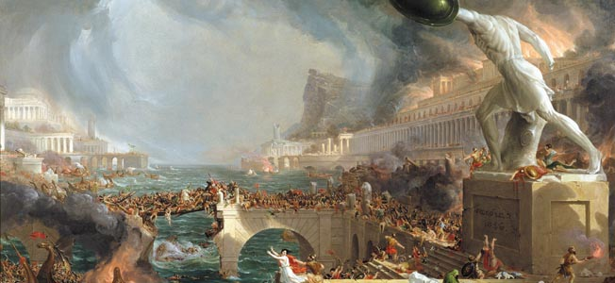
The Barbarian invasions and the decline of a glorious time.
Why, after a glorious period of 6 centuries, did bishops and priests become weak in knowledge and in holiness of life?
Rosmini produced a historical study, proving that the cause for such dramatic decline was the constant invasions of barbarian tribes who put to an end the mighty Roman Empire.
The barbarian kings, after destroying cities and murdering an endless number of innocent people, settled in the conquered lands of Europe, North Africa, and middle East, feared by everyone.
The people found protection in the Popes, bishops, and priests. The barbarian rulers, in order to control the population, bestowed titles and wealth on to the Popes and the Bishops.

Slide 70
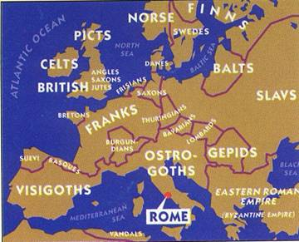
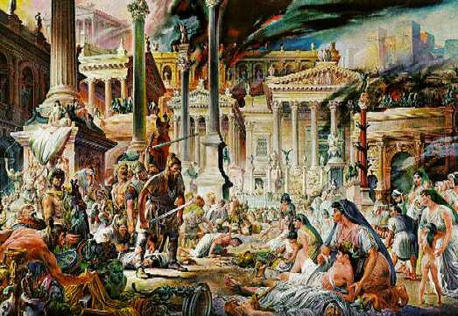
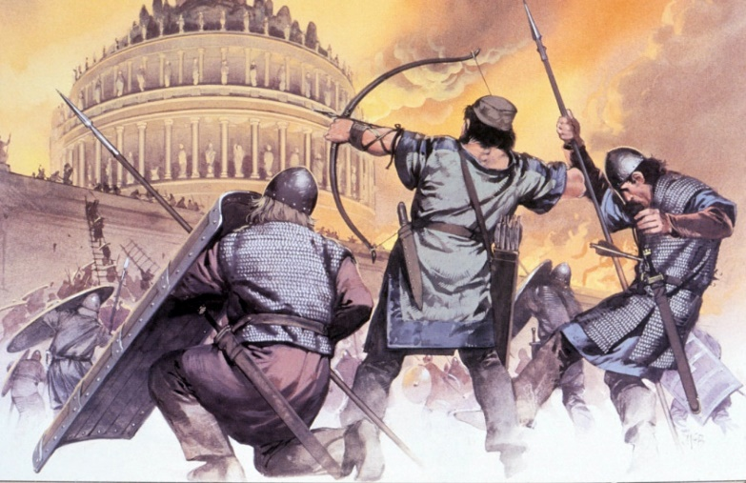
Barbarian Invasions
Sack of Rome
The Sack of Rome occurred on 24 August 410 AD. The city was attacked by the Visigoths led by King Alaric.

Slide 71
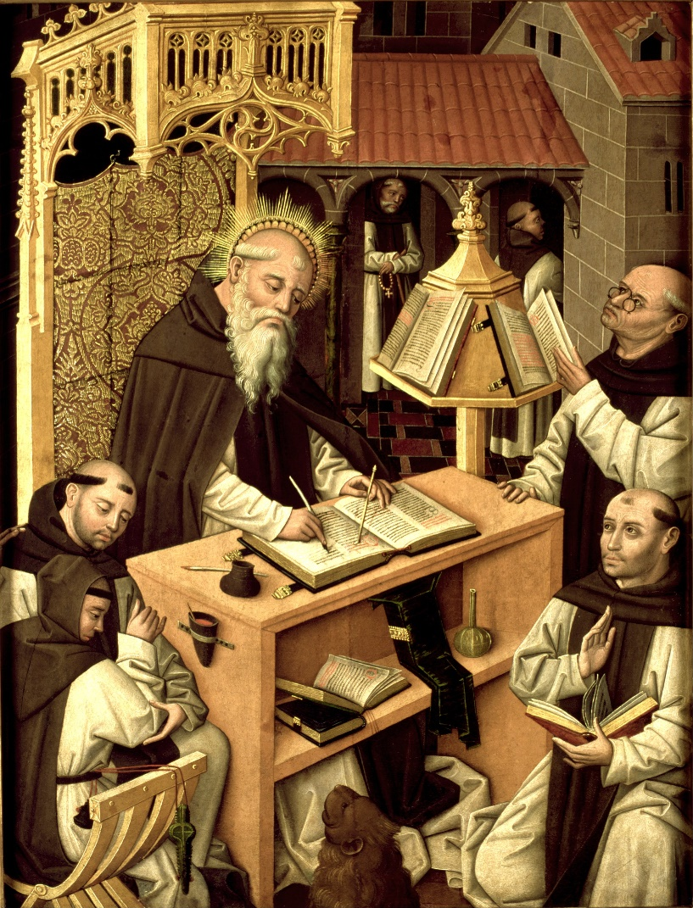
Secular business forced upon the charity of the Episcopate
The total collaps of political society had forced secular business upon the charity of the Episcopate.
But slowly Bishops became powerful, wealthy, and bound to their rulers; they became like princes, with their own army and their own fortresses.
It was at this stage that links with the people and the priests were broken. The priests, abandoned by their bishops in their spiritual needs, became corrupt, using the priesthood as a means of making money and of achieving some status in life.
Flourishing Orders of Canon and Monks undertook the Bishop’s work of educating Christian youth through the study of the works of the Bishops of old ages.
Claudio Clement
Bishop of Turin
+839

Slide 72
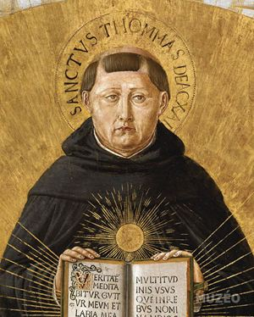
The teaching of Faith becomes a matter for Scholars
New teachers began slowly to write books that were mostly mere compendia or summae (e.g. the Sentences of Pietro Lombardo). Good books, but lacking the originality and strengh of the writes of the Fathers of the Church.
Theology was introduced in Universities (e.g. St. Thomas Aquinas +1274 and St. Bonaventure +1274).
Theological knowledge grew but wisdom decreased.
The schools acquired the restricted character that helped form the students into a class separate from other human beings.
The scientific method reduces the power of language and gives rise to the rationalism that will lead to Protestantism.
After the Golden Age of Scholars (the Summae of St. Thomas Aquinas) came the era of «Theologians», who ended up reducing Christian Doctrine to dry «formulas».
St. Thomas
Aquinas
1225-1274
St. Bonaventure 1217-1274
Itinerarium mentis in Deum

Slide 73
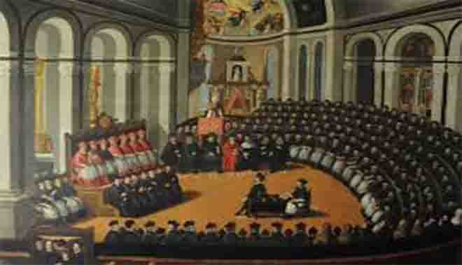
The Council
of Trent
1545-1563
Paul iii
The Council of Trent tried to stop the corruption of priests by creating “seminaries”, whereby vocations to the priesthood could live in a holy environment, with sound teaching and discipline of life.
Blessed Rosmini admitted that it was a great way forward. Unfortunately, the candidates to the priesthood had many books to learn but it was more “erudition” than wisdom.
They learned their philosophy from manuals, and their theology from summaries of very abstract formulas. They were not “formed” but simply informed, and in a very scholastic way.
There was no heart, no real converting of what was being learned into a holy life. There was a dysfunction between learning and life.
The second wound, therefore, persisted: inferior textbooks and inferior teachers formed inferior priests. They were in no position to revive the liturgy of the Sacraments by making people know and understand the beautiful things that should have warmed the hearts of the faithful.

Slide 74
Rosmini’s response in the apostolic constitution VERITATIS GAUDIUM 29.1.2018
In the Apostolic Constitution Veritatis Gaudium Pope Francis quotes Blessed Antonio Rosmini on the topic of remedies in the area of Christian Education:
4c In the nineteenth century, Blessed Antonio Rosmini called for a decisive reform in the area of Christian education, restoring the four pillars on which it firmly rested in the first centuries of the Christian era:
communion in learning,
holy intercourse
habit of life
interchange of affection
What is essential, he argued, is to restore the unity of content, perspective and aim of the science being taught, on the basis of the Word of God and its culmination in Christ Jesus, the Word of God made flesh.
Without this living centre, science has “neither root nor coherence” and simply remains “as a mere matter of youthful memory”.
Only in this way is it possible to overcome the “fatal separation of theory and practice”, for in the unity of science and holiness “we find the true spirit of that doctrine which is destined to save the world”.
For the teaching of that doctrine, in ancient times, “did not end with the brief daily lesson; it was continued in the constant intercourse of the disciple with his master”.

Slide 75
Ratio Fundamentalis Formationis 8° december 2016
Formation has an eminent communitarian character.
Seminaries should form missionary disceples who are «in love» with the Master.
The intellectual dimension, with the prescribed study of Philosophy and Theology, is not the only factor to be considered when evaluating the journey completed by the seminarian.
Rather the overall discernment will allow only those who have reached the level of human and vocational maturity required.
See also St. John Paul II Pastores dabo vobis Apostolic Exortation (25° March 1992) The four dimensions of Prieslty formation. nn. 43-59.

Slide 76
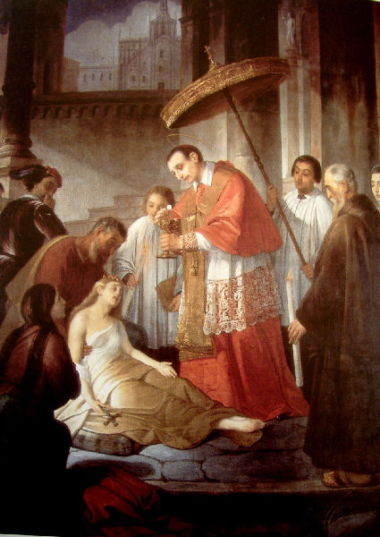
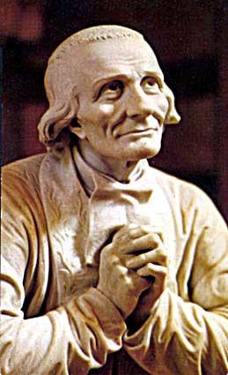
THE HEALING OF THE WOUND
The healing of this wound can only be brought about by the Bishops. It is their duty to “form” their priests, to be the shepherds of both priests and lay people.
Unfortunately, said Rosmini, there is a third wound which is the most serious and the cause of the second wound, and this is the lack of unity among bishops. There is division and different positions among bishops, how can they possibly “form” holy and great priests?
St. Charles Borromeo
St John Marie Vianney

Slide 77
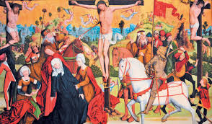
The third wound, of the Side of Jesus
The lack of unity among the bishops of the Church
The early Church was one in mind and heart. The Lord had stressed unity, and especially unity among His disciples: “May they be one...”
Early bishops were one body governing the Church with Peter or his successor.
They were one and insisted all the time about unity among Christians and Christian churches.
“Collegiality” is the modern term to express that the Church is ruled by one body, pope and bishops together, for the sake of the unity willed by JESUS for His own Body the Church.
Both St. Thomas Aquinas died going to the II Council of Lion and St. Bonaventure died while participating to it..

Slide 78
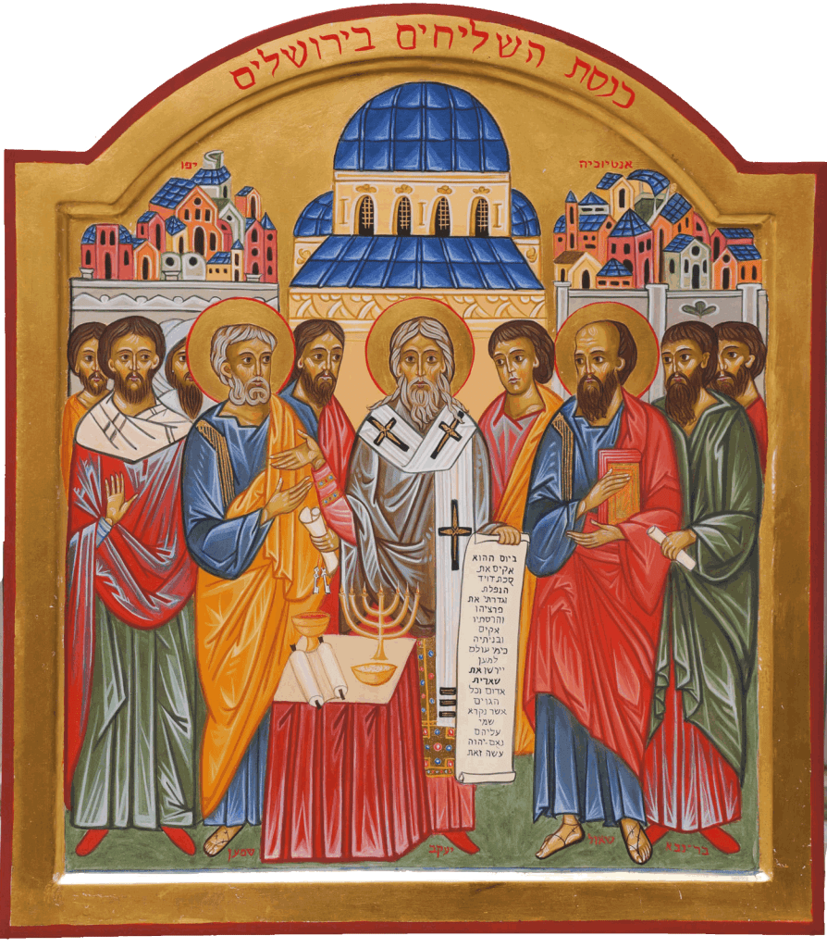
May they be one John 17:21
JESUS, before His passion and death, begged the Father to form his apostles into a perfect unity. Unity in the divine nature of the blessed Trinity is the source of unity within the Episcopate of the Church .
The Apostles guarded jealously their unity and the unity of their churches.
Their interior unity was guaranteed by their communion of doctrines and sacraments;
their exterior unity by the powerful links among the Apostles and their leader, Peter and later by their successors.
Although scattered throughout many nations, bishops were conscious of forming a single body of the highest authority. Their hearts and minds were dominated by this great concept of unity, and they used every possible means to bind themselves together. All maintained exactly the same faith, and love for each other.
How was this perfect unity achieved? Rosmini mentions “six golden links” that bound bishops together in perfect unity.
The Counsel of Jerusalem Cfr. Acts 15
¹ Certain people came down from Judea to Antioch and were teaching the believers: “Unless you are circumcised, according to the custom taught by Moses, you cannot be saved.” ² This brought Paul and Barnabas into sharp dispute and debate with them.⁶ The apostles and elders met to consider this question. ⁷ After much discussion, Peter got up and addressed them. ¹² The whole assembly became silent as they listened to Barnabas and Paul. ²² Then the apostles and elders, with the whole church, decided.

Slide 79
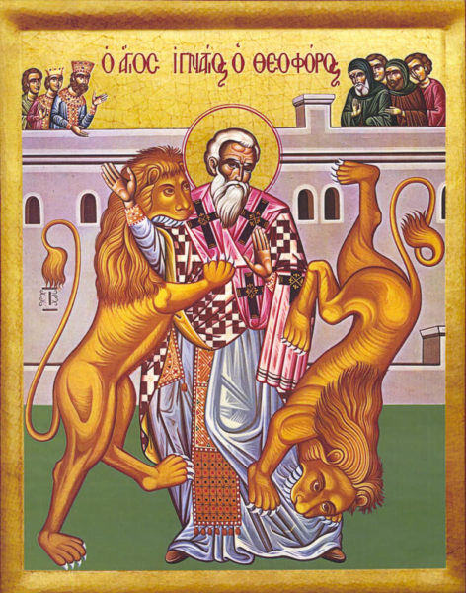
Six means in order to cultivate unity among the Bishops of the early ages.
Personal knowledge
Epistolary correspondence
Reciprocal visits and sharing about Church matters
Assemblies and Councils
Respect of the authority of the Metropolitan Bishops over the others.
Respect of the Supreme Authority of the Bishop of Rome.
St. Ignatius of Antioch 35-107 AD
author of the Seven Letters
to sixChristian Communities of his time and to St. Policarp
The Letter to the Ephesians, to the Magnesians, to the Trallians, to the Romans, to the Philadelphians, to the Smyrnaeans, to Polycarp, Bishop of Smyrna.

Slide 80
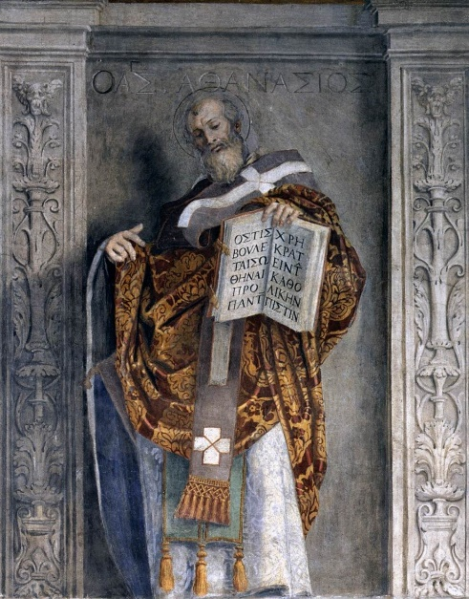
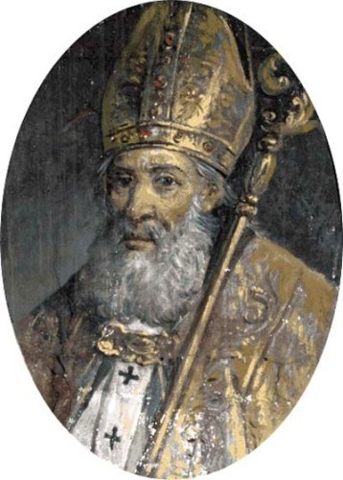
Personal knowledge and correspondence
1. Bishops knew one another personally.
Titus, Timothy, Polycarp, Ignatius, Irenaeus, John Chrysostom, Gregory of Nyssa, Gregory of Nazianzus were bishops who knew personally many other holy bishops even before they became bishops. It was well known that the house of St. Augustine was the house where many future holy bishops were formed. These great bishops formed other great bishops and kept their profound ties of Christian love and friendship.
2. Bishops, even the most isolated, were in constant correspondence, although they lacked the means of communication available to us.
The letters of bishops were read reverently at public assemblies. The Apostles wrote letters to their churches, other bishops followed their examples: Clement, Ignatius, Soter, Athanasius, John Chrysostom, etc. Particularly moving are the letters written by Ignatius to various churches as he was taken to Rome for his martyrdom.
St. Athanasius of Alexandria
St. Eusebius of Vercelli

Slide 81
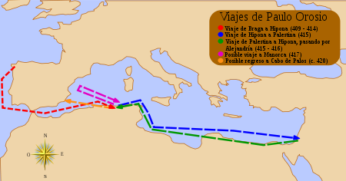
Paul Orosius 375-418 AD
As an example of a man who travelled and faced hardships in order to cultivate communion in the faith with Bishops and Pastors of the early Church, Rosmini refears to the life of and unknown protagonist of the history of Christian Spirituality of those times:
Paul Orosius was a Gallaecian Chalcedonian priest, historian and theologian, a student of Augustine of Hippo. It is possible that he was born in Bracara Augusta (now Braga, Portugal), then capital of the Roman province of Gallaecia.
He had contact with the greatest figures of his time such as Saint Augustine of Hippo and Saint Jerome. In order to meet with them Orosius travelled to cities on the southern coast of the Mediterranean Sea, such as Hippo Regius and Alexandria.
These journeys defined his life and intellectual output. Orosius did not just discuss theological matters with Saint Augustine; he also collaborated with him on the book City of God.
In addition, in 415 he was chosen to travel to Palestine in order to exchange information with other intellectuals. He was also able to participate in a Church Council meeting in Jerusalem on the same trip and he was entrusted with transporting the relics of Saint Stephen.
The date of his death is unclear, although it appears to have not been earlier than 418, when he finished one of his books, or later than 423.
He wrote a total of three books, of which his most important is his Seven Books of History Against the Pagans, considered to be one of the books with the greatest impact on historiography during the period between antiquity and the Middle Ages.

Slide 82
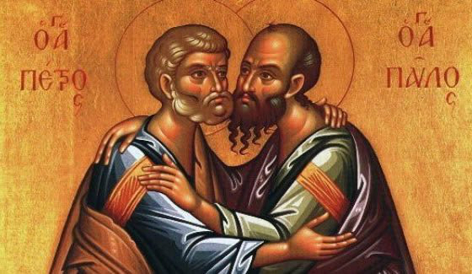
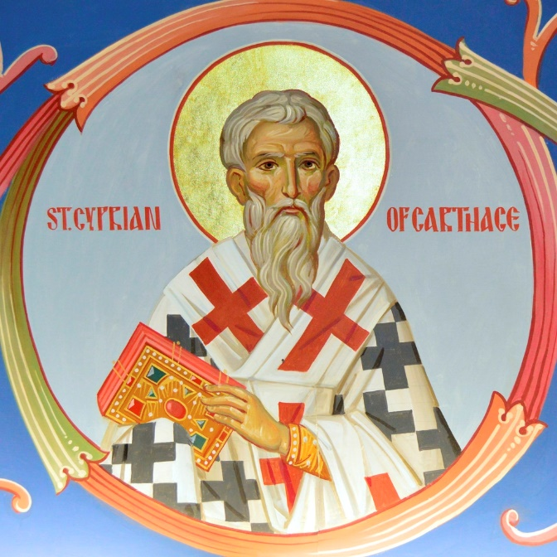
Meeting and gathering
3- The bishops visited one another out of mutual charity, or from zeal for church affairs. Their devotion embraced the universal church even more than the particular church entrusted to them. They were conscious of being bishops of the Catholic Church, and they realised that one diocese cannot be separated from the entire body of the faithful. Each local Church embodied the totality of the reality which is the Church, but their bishops were aware of the fundamental necessity of being one with the other bishops and with the bishop of Rome.
4- Assemblies and Councils, especially provincial councils, were held frequently. Bishops of a province sought each other for advice, for clarifying doctrine, for finding common solutions. Bishops would consult regularly with their priests and with the people, giving them an account of their government. People’s assent on all matters was valued so highly that if they rejected a bishop they were not forced to accept him and another suitable person was appointed in his place. St. Cyprian wrote to his priests, “At the beginning of my episcopacy I decided not to make any decision without your advice and the assent of the people”.
St. Peter and St. Paul meet on the way to martyrdom
St. Cyprian of Carthage 210-258 AD
He fought with St. Cornelius Pope against
the Novatianism.

Slide 83
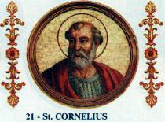
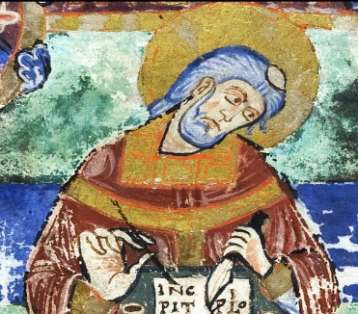
The Council of Chartage 251 AD
St. Cyprian was elected Bishop of Chartage in 248. Early in 250 the Decian persecution" began.
The persecution was especially severe at Carthage. Many Christians fell away, and were thereafter referred to as "Lapsi" (the fallen). The majority had obtained signed statements (libelli) certifying that they had sacrificed to the Roman gods in order to avoid persecution or confiscation of property. In some cases Christians had actually sacrificed, whether under torture or otherwise. Cyprian found these libellatici especially cowardly, and demanded that they and the rest of the lapsi undergo public penance before being re-admitted to the Church.
However, in Cyprian's absence, some priests disregarded his wishes by readmitting the lapsed to communion with little or no public penance.
A schism then broke out in Carthage, as the laxist party, led largely by the priests who had opposed Cyprian's election, attempted to block measures taken by him during his period of absence.
After issuing a tract, "De lapsis," (On the Fallen) he convoked a council of North African bishops at Carthage to consider the treatment of the lapsed (251). Cyprian took a middle course between the followers of Novatus of Carthage who were in favour of welcoming back all with little or no penance, and Novatian of Rome who would not allow any of those who had lapsed to be reconciled. The council in the main sided with Cyprian.
The schism continued as the laxists elected a certain Fortunatus as bishop in opposition to Cyprian. At the same time, the rigorist party in Rome, who refused reconciliation to any of the lapsed, elected Novatian as bishop of Rome, in opposition to Pope Cornelius. The Novatianists also secured the election of a certain Maximus as a rival bishop of their own at Carthage. Cyprian now found himself wedged between laxists and rigorists, but the polarization highlighted the firm but moderate position adopted by Cyprian and strengthened his influence, wearing down the numbers of his opponents. Moreover, his dedication during the time of a great plague and famine gained him still further popular support.
Cyprian comforted his brethren by writing his De mortalitate, and in his De eleemosynis exhorted them to active charity towards the poor, setting a personal example. He defended Christianity and the Christians in the apologia Ad Demetrianum, directed against a certain Demetrius, in which he countered pagan claims that Christians were the cause of the public calamities.
At the end of 256 a new persecution of the Christians broke out under Emperor Valerian, and Pope Sixtus II suffered martyrdom in Rome. Cyprian was at first exiled and then beheaded.
Novatian Antipope
Fortunatus. Schismatic
laxist Bishop of Chartage

Slide 84
The foundation of authority and the virtue of obedience
5- The metropolitan bishop had authority over the bishops of a province, while greater sees had several provinces and metropolitans subject to them. This arrangement provided for uniformity in doctrine and in practice and strengthened the bonds among churches and bishops.
6- The overall authority of the Pope which was the foundation rock of the unity of the universal Church. In all their serious needs bishops and churches of the entire world appealed to him as to a father, judge, teacher, leader, centre and common source. Rome was seen as the great see where sound doctrine and the unity of the Church on earth could be found visibly in the successor of St. Peter. The pope was the symbol of unity of the universal Church, and bishops made continuous pilgrimages to Rome to pray over the tomb of St. Peter and to report to the Pope.
St. Clement I Pope (+99 AD). In his letter to the church at Corinth he asserted the authority of the presbyters as rulers of the church on the ground that the Apostles had appointed such. His letter is one of the oldest extant Christian documents outside the New Testament, was read in church, along with other epistles, some of which later became part of the Christian canon. These works were the first to affirm the apostolic authority of the clergy.

Slide 85
The establishment of the Feudal System
This golden era of the Church came to end after six centuries.
The same destructive force that was responsible for the insufficient education of the clergy was also the cause of the progressive disunion among the bishops: the end of the Roman Empire and the sustained invasions of barbarian kings, with the establishment of the feudal system.
In the crumbling of the old systems, the bishops became the intermediaries between the people and the barbarian rulers and they were forced to enter the political arena acquiring in the process power, wealth, and privileges.
After the sack of Rome done on 24 August 410 AD when the city was attacked by the Visigoths led by King Alaric,
Pope St. Leo I or Leo the Great in 452 he encountered Attila the Hun near Mantua, and persuaded him not to proceed to the sack of Rome.
Again, in 455, he met the Vandal Gaiseric outside the walls of Rome and succeeded in preventing the city’s wholesale destruction.

Slide 86
From free Apostles of the naked Christ to slaves of men dressed in soft garments
The “Christianisation” of Europe was the result of the presence and influence of bishops and clergy in public administration, but such involvement brought also evil consequences for the Church.
The bishops soon learned to love their new political status, and surrounded themselves with courtiers, armies, and all the externals that they envied in royal princes. They devised protocols, invented titles, built palaces, and generally, distanced themselves both from their lower clergy and from the people.
Avarice, hatred, disharmony, lust, licentiousness became widespread among them, having been made subservient to their rulers who guaranteed their position.
“They became slaves of men dressed in soft garments rather than free apostles of a naked Christ”.
The bishops’ political involvement and power was the cause of profound disunion among them.
Some clerics are remembered mainly for their war records. Robert of Geneva, a cardinal and papal legate, was one. He is most notable for his part in the papacy's battle against Florence. At Cesena in 1377 he persuaded the locals to lay down their arms with promises of mercy. When they did he sent in his mercenaries to kill them — 8,000 men, women and children.
A future Bishop of the same Diocese will be St. Francis of Sales (1567-1622), who will be a Holy Sheperd of mercie and meekness, a source of inspiration for our own Spirituality.

Slide 87
The feudal system

Slide 88
The feudal system enters into the Church
Fortified
Bishop’s Palace
Wells-England
Medieval Fortified Monastry
Tatev-Armenia

Slide 89
CONSEQUENCES

Slide 90
Antipopes MANIPULATED by secular powers
Some of the Antipopes of the history of the Church
In 418 the archdeacon Eulalius was elected by a faction partial to him, and he was supported by the imperial prefect and the Byzantine court. The rest of the clergy, however, chose the priest Boniface I, who was eventually given official recognition by the emperor.
In the 7th century Paschal and Theodore were rivals for the papacy, and both were unwilling to renounce their claims. Finally, a part of the community more inclined to moderation gained the papacy for Sergius I.
In 1059 a new procedure for electing popes, proclaimed by Pope Nicholas II, deprived the German emperors of the leading role that they had played in earlier papal elections and also limited the influence of the Roman nobility. This led to the election of the antipope Honorius II in opposition to the canonically elected Alexander II, who was eventually recognized by the emperor.
in the 14th century the official residence of the papacy was moved to Avignon, France. This led to a schism (the Great Western Schism) beginning in 1378 that resulted in a papacy in Rome (regarded as canonical), a papacy in Avignon (regarded as antipapal), and eventually a third papacy established by the Council of Pisa (also regarded as antipapal). Unity was finally achieved by the election of Martin V on Nov. 11, 1417.
Eulalius
Antipope
Honorius II
Antipope
John XXIII
Antipope in Avignon
Paschal III
Antipope

Slide 91
THE EASTERN SHISM 1054 AD
The East–West Schism, also called the Great Schism and the Schism of 1054, was the break of communion between what are now the Catholic Church and Eastern Orthodox churches, which had lasted until the 11th century. The Schism was the culmination of theological and political differences between the Christian East and West which had developed over the preceding centuries.
A succession of ecclesiastical differences and theological disputes between the Greek East and Latin West pre-dated the formal rupture that occurred in 1054. Prominent among these were the issues of the procession of the Holy Spirit, whether leavened or unleavened bread should be used in the Eucharist, the Bishop of Rome's claim to universal jurisdiction, and the place of the See of Constantinople in relation to the Pentarchy, linked to the laws of Emperor Justinian I of the Byzantine Empire.
In the model, the Christian church is governed by the patriarchs of the five major episcopal sees of the Roman Empire: Rome, Constantinople, Alexandria, Antioch, and Jerusalem. Communion is now suffocated by a battle for power.
Protagonists where Pope Leo IX, Michael I Cerulario Patriarc of Costantinople and Imperor Constantine IX.
Pope Leo IX, who tried
Strongly to preserve unity
And to avoid the Schism

Slide 92
THE REFORMATION AND THE PROTESTANT SCHISM - 1517
The Reformation, or Luteran Schism, is usually considered to have started with the publication of the Ninety-five Theses by Martin Luther in 1517. The Edict of Worms, 1521, condemned Luther and officially banned citizens of the Holy Roman Empire from defending or propagating his ideas.
Luther began by criticising the sale of indulgences, insisting that the Pope had no authority over purgatory and that the Treasury of Merit had no foundation in the Bible. The Reformation developed further to include a distinction between Law and Gospel, a complete reliance on Scripture as the only source of proper doctrine (sola scriptura) and the belief that faith in Jesus is the only way to receive God's pardon for sin (sola fide) rather than good works.
During the Reformation confessionalization, Western Christianity adopted different confessions
Catholic
Lutheran
Reformed
Anglican
Anabaptist
Unitarian
and others.
This deepened even more the wound of division inside the Church of Christ.
The 95 thesis Martin Luther sent
on 31 October 1517
to Archbishop Albert of Brandenburg.
Prince Frederick III
Elector of Saxonia, who protected
and sustained
Martin Luther
against the Pope
and the
Archibishop of Mainz
and promoted the election of Emperor Charles V

Slide 93
The Anglican Schism 1534 AD
The Anglican Schism was initially driven by the dynastic goals of Henry VIII, who, in his quest for a consort who would bear him a male heir, found it expedient to replace papal authority with the supremacy of the English crown.
The early legislation focused primarily on questions of temporal and spiritual supremacy. The Institution of the Christian Man (also called The Bishops' Book) of 1537 was written by a committee of 46 divines and bishops headed by Thomas Cranmer.
The purpose of the work, along with the Ten Articles of the previous year, was to implement the schism of Henry VIII in separating from the Roman Catholic Church and reforming the Ecclesia Anglicana.
The Dissolution of the Monasteries and the seizure of their assets by 1540 brought huge amounts of church land and property under the jurisdiction of the Crown, and ultimately into the hands of the English nobility.
This simultaneously removed the greatest centres of loyalty to the pope and created vested interests which made a powerful material incentive to support a separate Christian church in England under the rule of the Crown.
King Henry VIII
Archibishop
Thomas Cranmer
St. Thomas More
Martyr
Lord Chancellor of Henry VIII

Slide 94
Only going back to a simple and pour life
the Church will find again unity and freedom.
Rosmini claims that the catholic faith might have been saved in some nations if the Church had been freed of the wealth that endangered it.
“But is it really possible to find an immensely wealthy clergy courageous enough to impoverish itself, or even with enough sense to understand that impoverishing the Church is to save her?”
The Church longs for freedom not for wealth. Free from all political interference, and free from political involvement and wealth, the Bishops, poor and simple like the Apostles, would once again become a beacon of communion among themselves and ready to pursue with vigour the preaching of the Kingdom of God to all creatures.
But to achieve this political disentanglement the election of bishops must be a matter for the Church exclusively. It cannot be achieved unless the fourth wound of the Church is first healed.
12th April 1207: in the square of Assisi St. Francis gives back to his Father, Pietro of Bernardone, his wich clothes and leaves the world for a life of poverty. Some friends will follow him. It’s the beginning of the Franciscan Order.

Slide 96
LUMEN GENTIUM n. 22 THE APOSTOLIC COLLEGE
Just as in the Gospel, the Lord so disposing, St. Peter and the other apostles constitute one apostolic college, so in a similar way the Roman Pontiff, the successor of Peter, and the bishops, the successors of the apostles, are joined together.
Indeed, the very ancient practice whereby bishops duly established in all parts of the world were in communion with one another and with the Bishop of Rome in a bond of unity, charity and peace, and also the councils assembled together, in which more profound issues were settled in common, the opinion of the many having been prudently considered, both of these factors are already an indication of the collegiate character and aspect of the Episcopal order; and the ecumenical councils held in the course of centuries are also manifest proof of that same character.
And it is intimated also in the practice, introduced in ancient times, of summoning several bishops to take part in the elevation of the newly elected to the ministry of the high priesthood. Hence, one is constituted a member of the Episcopal body in virtue of sacramental consecration and hierarchical communion with the head and members of the body.
But the college or body of bishops has no authority unless it is understood together with the Roman Pontiff, the successor of Peter as its head.
ALL THE CHAPTER ON THE HIERARCHICAL STRUCTURE OF THE CHURCH IS MODELED ON THE VALUE OF COMMUNION (see. Nn. 23-28)

Slide 97
DECREE CONCERNING THE PASTORAL OFFICE OF BISHOPS IN THE CHURCH CHRISTUS DOMINUS PROCLAIMED BY HIS HOLINESS, POPE PAUL VI ON OCTOBER 28, 1965
CHAPTER I
THE RELATIONSHIP OF BISHOPS TO THE UNIVERSAL CHURCH
I. The Role of the Bishops in the Universal Church
4. By virtue of sacramental consecration and hierarchical communion with the head and members of the college, bishops are constituted as members of the episcopal body. "The order of bishops is the successor to the college of the apostles in teaching and pastoral direction, or rather, in the episcopal order, the apostolic body continues without a break. Together with its head, the Roman pontiff, and never without this head it exists as the subject of supreme, plenary power over the universal Church. But this power cannot be exercised except with the agreement of the Roman pontiff." This power however, "is exercised in a solemn manner in an ecumenical council." Therefore, this sacred synod decrees that all bishops who are members of the episcopal college, have the right to be present at an ecumenical council.
"The exercise of this collegiate power in union with the pope is possible although the bishops are stationed all over the world, provided that the head of the college gives them a call to collegiate action, or, at least, gives the unified action of the dispersed bishops such approval, or such unconstrained acceptance, that it becomes truly collegiate action.
5. Bishops chosen from various parts of the world, in ways and manners established or to be established by the Roman pontiff, render more effective assistance to the supreme pastor of the Church in a deliberative body which will be called by the proper name of Synod of Bishops. Since it shall be acting in the name of the entire Catholic episcopate, it will at the same time show that all the bishops in hierarchical communion partake of the solicitude for the universal Church.

Slide 98
Christus Dominus - Reform of the Roman Curia.
II. Bishops and the Apostolic See
nn. 8 and 9
8. (a) To bishops, as successors of the Apostles, in the dioceses entrusted to them, there belongs per se all the ordinary, proper, and immediate authority which is required for the exercise of their pastoral office. But this never in any way infringes upon the power which the Roman pontiff has, by virtue of his office, of reserving cases to himself or to some other authority.
(b) The general law of the Church grants the faculty to each diocesan bishop to dispense, in a particular case, the faithful over whom they legally exercise authority as often as they judge that it contributes to their spiritual welfare, except in those cases which have been especially reserved by the supreme authority of the Church.
9. In exercising supreme, full, and immediate power in the universal Church, the Roman pontiff makes use of the departments of the Roman Curia which, therefore, perform their duties in his name and with his authority for the good of the churches and in the service of the sacred pastors.
The fathers of this sacred council, however, desire that these departments-which have furnished distinguished assistance to the Roman pontiff and the pastors of the Church-be reorganized and better adapted to the needs of the times, regions, and rites especially as regards their number, name, competence and peculiar method of' procedure, as well as the coordination of work among them.(8) The fathers also desire that, in view of the very nature of the pastoral office proper to the bishops, the office of legates of the Roman pontiff be more precisely determined.
10. Furthermore, since these departments are established for the good of the universal Church, it is desirable that their members, officials, and consultors as well as legates of the Roman pontiff be more widely taken from various regions of the Church, insofar as it is possible. In such a way the offices and central organs of the Catholic Church will exhibit a truly universal character.

Slide 99
The Constitutions of the Society of Charity
Constitutions n. 185
In the first place the greates care is to be taken with regard to union and mutual agreement.
Nothing must be permitted to interfere with this aim, because the bond of fraternal charity enables the members to devote themselves better and more effectively to the worship of God and the assistance of their neighbours.
Then Rosmini points out some good attitudes:
Inclining towards other’s opinions
Linstening carefully to one another
Exercising mutual correction with discretion and charity
Keeping ourselves humble in heart
Enjoiing the growt in wisdom that consentment brings to our minds and to our hearts.
Constitutions n. 1064
Whatever helps towards union between the members of this body amongst themselves and with their head will also greatly help to covserve its well-being.
This applies in the first plase to the bond of wills which is charity and mutual love, the true mark of the disciples of Jesus Christ.
Constant communication and interchange of news, the same doctrine and love of truth, and uniformity (in so far as possible without restricting a wider good) will nourish this love.
But above all things, the well-being of the Society will be preserved by the bond of obedience, which unites individuals with their supeior, and superiors amongst themselves and with the General.
On their part, superiors in ruling should use the power of command and the staff of direction without harsh domineering, so that work may be carried out devotedly and vogorously, and the exquisite beauty of subordination may be universally manitained.

Slide 100
Institutional means of communion today
In the Church
Councils
Episcopal Conferences
Synods
Assemblies and Congresses
Local Gathering
Diocesan
At the level of Pastoral Areas
At the level of Deaneries
Diocesan and Parish Pastoral Councils CIC 536
Finance Councils CIC n. 537
In the Institute
General and Provincial Councils
Chapters
Province meetings and assemblies
Community meetings
Community «Consulta»
Institute of Charity
General Congregation 2018
Audience wit the Holy Father

Slide 101
Jean-Baptiste Henri-Dominique Lacordaire (12 May 1802 – 21 November 1861), often styled Henri-Dominique Lacordaire, was a French ecclesiastic, preacher, journalist, theologian and political activist. He re-established the Dominican Order in post-Revolutionary France. Lacordaire was reputed to be the greatest pulpit orator of the nineteenth century.
He cooperated to L’Avenir with Lammennais, but after Mirari vos submitted to the decisions of Pope Gregory XVI. He sustained the need of freedom of the people of Europe, and a need of freedom in Europe for the Church.
AN APPEAL FOR FREEDOM
Rosmini ends the chapter on the Second Wound referring to him:
Perhaps the real need is for freedom to allow religion to communicate directly with the heart of the people irrespective of the mediation of rulers and governments.
So he introduces his readers to the Fourth Wound, the wound of the right foot of Holy Church: the nomination of Bishops left in the hands of civil governments.

Slide 102
The fourth wound, the wound in the right foot.
The nomination of bishops left in the hands of civil governments
For over a thousand years, and at the times of Rosmini, emperors, kings, and political rulers in Europe and world-wide had arrogated to themselves by force or had been given by the Church under duress the right to nominate bishops for the sees in their countries.
The Pope was simply demanded to or reserved to himself the right to “confirm” their nominations.
This is the “wound” Rosmini is highlighting in this chapter, but in presenting it and in giving a most painful historical account of the way a “free” Church became enslaved to civil governments
He also suggests that the Church ought to go back to the practice of the early Church when bishops were elected by the clergy and the people.
It was this second issue that fired up people’s and theologians’ thinking right up to our own times, and that became the pretext for the condemnation of the book.

Slide 103
The election of Bishops:
a moral divine right of Clergy and People
in the Church
For Rosmini, the clergy and the people had a “divine” right to elect their shepherd.
He was asked by the Pope, Pius IX, to clarify this theological point which seemed to declare “invalid” elections of bishops who had been nominated by rulers only, with the approval of the Pope.
Other bishops and theologians made the same request, and Rosmini obliged by publishing three letters written to Canon Giuseppe Gatti.
He distinguishes between “divine constitutive right” and “divine moral right”.
The right clergy and people have in the elections of bishops is “divine moral right” only and the violation of this right does not cause “invalidity”.
But IT IS THE POPE who has indeed the authority to by-pass this right of clergy and people if pressed by other serious considerations.
Pope St. Pius IX
1792-1878

Slide 104
The election of Bishops by Clergy and People
was a tradition in the ancient Church
History shows as an undeniable fact that in the greatest Churches founded by the Apostles, in the churches of Rome, Alexandria, Antioch, Constantinople, Ephesus, Caesarea, Heraclea, Corinth, Thessalonica, Carthage and others, the people took an active part for many centuries in the ordinary choice of bishops.
A bishop without the support and approval of the people was considered an unlawful usurper.
This tradition remained secure and universal during the first six centuries of the Church.
The invasions of barbarian armies which brought to an end the old Roman Empire caused dramatic changes in the Church especially in her status as a poor but free Mother of all her subjects.
The new barbarian rulers favoured the Church with wealth and power while at the same time enslaving her through the bishops who became progressively political princes subjected to the authority of the rulers.
Ambrose acclamed by the
People in Milan 374 AD

Slide 105
Charles the Great (742-814)
King of the Franks from 768, king of the Lombards from 774, and emperor of the Romans from 800, crowned by Pope Leo III.
He united much of western and central Europe during the Early Middle Ages.
He was the first recognised emperor to rule from western Europe since the fall of the Western Roman Empire three centuries earlier.
The expanded Frankish state that Charlemagne founded is called the Carolingian Empire or Sacred Roman Empire. He was later canonized by Antipope Paschal III.
Charlemagne expanded the reform Church's programme
The deepening of the spiritual life was later to be seen as central to public policy and royal governance.
His reform focused on strengthening the church's power structure, improving clergy's skill and moral quality, standardising liturgical practices,
improvements on the basic tenets of the faith
and the rooting out of paganism.
His authority extended over church and state. He could discipline clerics, control ecclesiastical property and define orthodox doctrine. Despite the harsh legislation and sudden change, he had developed support from clergy who approved his desire to deepen the piety and morals of his subjects.
In 809–810, Charlemagne called a church council in Aachen, which confirmed the unanimous belief in the West that the Holy Spirit proceeds from the Father and the Son (ex Patre Filioque).

Slide 106
FROM ROYAL ASSENT TO TOTAL SUBJECTION
But all the efforts to safeguard this fundamental principle of freedom for the Church produced little results before determined and powerful kings and princes bent on accumulating all authority and dominion on themselves.
They spoke initially of “royal assent” to the ordination of bishops, then they considered bishops as their subjects and their properties as properties of the king.
It happened often that at the death of a bishop the king would not appoint a new bishop for a long period so that he may enrich himself with all the revenues of the dead bishop’s properties.
It often happened that the king would offer the office of bishop to the highest bidder.
Otto II 955-983 AD
Imperor of the Sacred Roman Empire

Slide 107
A CHURCH struggling for FREEDOM
8° september 1301.
The slap of Anagni. Pope Boneface VIII is fisically assaulted and humiliated by Sciarra Colonna, member of a power family of Rome, who invades the Papal Palace of Anagni with the forse of soldiers recuited by Guillaume Nogaret, Minister of the French King Philip IV the Fair, upset by the Letter Unam Sanctam and by the strong fight of Boniface for a Church free from secular power. Knocked down on the floor the Pope said: ”Here is my head, here my neck. I will die, but I will die as a Pope”
1077 - Imperor Henry the IV comes in penance at the feed of Pope Gregory VII asking to be readmitted into the Church after having appointed schismatic Bishops in Germany

Slide 108
FOUR FOUNDAMENTAL PRINCIPLES IN THE ELECTION OF BISHOPS
IN FAVOUR OF INDEPENTENT CHURCH ELECTION
This was the situation at the time of Rosmini. He makes a powerful case inviting kings and emperors to give up their ill-gotten privilege to nominate bishops.
He reasons with them and argues that it is in their best interest to let the Church of God free to choose her bishops. He lists four fundamental principles in the election of bishops which, he argues, can be properly fulfilled by the Church, never by the State:
1. “The best person available should be chosen as bishop”: who is in the better position to judge the qualities required of a bishop, the Shepherd of his flock, who leads his people in the way of holiness by sound doctrine and moral up-righteousness?
2. “The priest chosen should be known, loved and wanted by those whom he has to govern”: the church’s desire to have as father and pastor the priest it feels more at home with is good and reasonable. But if rulers nominate the bishops, the people’s wishes are rarely listened to.
Card. Mariano Rampolla
Franz Joseph
During the Conclave of 1903
through Cardinal Jan Maurycy Pawel Puzyna de Kosielsko, the Prince-Bishop of Kraków, subjected to his authority,
Emperor Franz Joseph of Austria asserted the right claimed by certain Catholic rulers to veto a candidate for the papacy, blocking the election of the leading candidate, Cardinal Secretary of State Mariano Rampolla.

Slide 109
A Bishop should know well his people
and his people should trust him
3. “The priest chosen as bishop should have been enrolled for a lengthy period amongst the clergy of the diocese he is to govern, and not be sent there as a stranger from a distant country”: it is in the best interest of the local church that the person who is going to be the father of all is known to all. Rulers follow favouritism and personal interest, not the interest of the people.
4. “Generally speaking, only the moral body or moral person concerned is capable of judging what is best for itself”: the Church is a spiritual and moral reality, and her interest and mission differ widely from the preoccupations of civil governments. The Church knows what is best for her, and the Christian people know what is in their best interest in matters related to their salvation.
Finally, Rosmini, after giving his full approval to the maxim established by Leo the Great: “The person governing all should be chosen by all”.
Saint Oscar Romero Martir
Bishop among his people
Assassinated on 24° March 1980
because defending the pour
against the totalitaristic regime
of San Salvador

Slide 110
ROSMINI sums up the duties and rights of the people of God in the election of their bishop:
1. To BEAR WITNESS to the virtue and suitability of the bishop they are to receive.
They have the right to make known defects as Cyprian says, “so that in the people’s presence good and evil may be discerned”.
2. To EXPRESS THEIR DESIRE and request for the bishop whose virtues they witness to. The bishops of Alexandria in supporting the election of St. Athanasius maintained that he became bishop when “the entire crowd, together with the whole assembly of the catholic church, united as one body and soul, cried out and shouted for Athanasius as bishop of the church. They publicly begged this of Christ, and beseeched us for it for many days and nights, neither leaving the church nor allowing us to leave it. We ourselves, this city, and the whole of the province are witnesses of the fact”.
3. To REFUSE A BISHOP WHO HAS BEEN CHOSEN, provided the refusal is the work of the majority or the more reliable part of those belonging to the diocese. St. Celestine prescribes that “no bishop shall be given to people unwilling to receive him”. This is a kind of veto recognised by the Church as a right belonging to Christian people.

Slide 111
What about today?
1. Totalitary regimes …
Chinese priests appointed by the regime
Most civil governments have, thankfully, surrendered the “privilege” of electing their own bishops, recognising the freedom of the Church in such important matter; we say “most” because we are aware that State interference has not ceased everywhere, see China, Cuba, and States with a totalitarian regime.
But, what about the “divine moral right” of clergy and people to elect their bishops?
In some of the Islamic countries, often Catholics are denied very basic rights:
carrying a Bible in their case,
building Churches,
opening Catholic schools.

Slide 112
What about today?
2. Democratic Countries …
But even in democratic countries, there are a number of issues about the rights of the Church:
the right to have our own schools and our own teachers,
the right to give children for adoption or fostering to couples who are Catholic,
the right of having help for families with many children,
The Church does not want “privileges” but that which is just, and freedom to evangelize.

Slide 113
The fifth wound, in the left foot of Jesus
Enslavement of the wealth of the Church
Even from a cursory reading of the pages of the fifth wound it is clear that Rosmini’s vision of the Church is that of the Spouse Christ embracing the same poverty of her Bridegroom, who said, “Foxes have holes, and birds of the air have nests; but the Son of man has nowhere to lay His head” (Matthew 8:20).
Rosmini asks that popes, bishops, and priests embrace evangelical poverty, as it was the case in the early Church.
“The profession of poverty was for long the glory of the priestly ministry; the majority of men called to the priesthood abandoned their possessions or gave them away to the poor… The outstretched hands of the poor, of widows, lepers, slaves, pilgrims and the destitute became vaults where the Church could deposit her treasures without fear of theft”.

Slide 114
Two are the lines followed by Blessed Rosmini:
In the long history of the Church and at the time of Rosmini, Kings and Emperors often felt that they could take over properties and wealth belonging to the Church. Henry VIII did it, many French Kings did it, and the Austrian Emperors as well. Rosmini fought against this periodic robbing of the Church by civil powers.
The Church, called by JESUS to poverty, had become rich and no longer able to imitate the lifestyle of JESUS and of the early communities. Rosmini called for real poverty of bishops and clergy.
The early Church was poor, but free. Her evangelical poverty was safeguarded by seven maxims which regulated the acquisition, administration and use of material goods. Rosmini explains these ancient maxims with a passionate plea that the Church of his time, the Church of our time, may embrace them once again if she is to be the salt of the earth and the light of the world.

Slide 115
Seven maxims by which the early Church safeguarded her evangelical poverty regulating the acquisition, administration and use of material goods.
All offerings to the church have to be “spontaneous”.
Goods should be possessed, administered and dispensed in common.
The clergy should use church goods only for the strict needs of their maintenance.
Ecclesiastical wealth used for pious, charitable purposes, should also be assigned to fixed, determined works.
“A generous spirit, prompt to give, slow to receive” should be cultivated.
The administration of all Church possessions should be made public.
The Church should administer her goods watchfully and carefully.

Slide 116
The first requirement was that
ALL OFFERINGS TO THE CHURCH HAD TO BE “SPONTANEOUS”.
Christ obliged the faithful to maintain those working for the gospel, but He appealed to the faithful’s free acceptance of His gospel, and to their moral response. St. Paul, although acknowledging that he had the moral right “to food and drink” for preaching the gospel, seldom used it preferring to work hard for his food and the food of his own companions.
Moreover, the obligation that Christ imposed on the faithful of maintaining the clergy did not extend beyond the strict needs of the preachers of the gospel, “Remain in the same house, eating and drinking what they may provide” (Luke 10:7).
This maxim is stressed by Tertullian at the beginning of the third century, “Each one who can, puts aside some money monthly, or when he decides. No one is forced; all give spontaneously. These funds are the investments of piety”.
Spontaneity only ceased when the offerings were enforced by sanctions imposed by the secular arm.

Slide 117
The second maxim protecting the Church from corruption was that
GOODS SHOULD BE POSSESSED, ADMINISTERED AND DISPENSED IN COMMON.
Initially the faithful brought the proceeds of what was sold and laid it at the apostles’ feet.
Distribution was made to each as any had need. We can only admire the love and union between the believers, and wonder at the common life amongst clergy and faithful.
This requirement was preserved for a long time. The bishop, as successor of the Apostles, normally distributed each month what was necessary for the maintenance of the clergy who worked for the gospel in their dioceses.
The funds came from church possessions; no one had anything of his own.

Slide 118
The third, precious maxim was that
THE CLERGY SHOULD USE CHURCH GOODS ONLY FOR THE STRICT NEEDS OF THEIR MAINTENANCE
The remainder was to be applied to pious works, especially in alms for the poor.
Christ founded the apostolate on poverty, and on abandonment to Providence, He himself was the perfect example.
Hence in the finest period of the Church, entering the ranks of the clergy was equivalent to a profession of evangelical poverty.
The profession of poverty was for long the glory of the priestly ministry; the majority of men called to the priesthood abandoned their possessions or gave them away to the poor.
These men never used the wealth of the Church for their own benefit as though it belonged to them, but accepted it in trust for the poor.

Slide 119
The fourth requirement governing Church goods and safeguarding the integrity of the clergy was that
ECCLESIASTICAL WEALTH USED FOR PIOUS, CHARITABLE PURPOSES, SHOULD ALSO BE ASSIGNED TO FIXED, DETERMINED WORKS
This to prevent arbitrariness and self-interest from interfering with the management of the goods.
In the early Church resources were allotted to definite purposes according to a fourfold division: for the support of the bishop, the clergy, the poor, and for the upkeep of church buildings and cult.
“It is certain – says Rosmini – that the best remedy against the corruption accompanying riches was the establishment of laws at various Councils regulating the precise uses to which they could be applied”.
The corruption and ruin of many ancient monasteries is to be attributed to the lack of precise purposes to direct the great riches possessed by religious houses. As a result, abbots and other superiors controlling finances spent the income as they pleased.

Slide 120
The fifth requirement safeguarding the Church from the danger of riches was:
“A GENEROUS SPIRIT, PROMPT TO GIVE, SLOW TO RECEIVE”.
The great rule fixed in human hearts was Christ’s noble words, “It is more blessed to give than to receive”. Bishops considered money and administration a burden, to be borne only for motives of charity.
St. Ambrose refused legacies and donations if he knew that poor relatives of the donor would suffer as a result. St. Augustine had to defend himself against the accusation, “Bishop Augustine gives with total generosity, but takes nothing”.
What a glorious accusation, says Rosmini!

Slide 121
The sixth requirement compelled the Church to
Make public the administration of all her possessions.
In the early Church bishops consulted the clergy and the people on all matters, including the use of the wealth of the Church. Moreover, the priests and deacons in charge of the administration had to be approved by the whole church, according to Apostolic tradition.
St John Chrysostom was not afraid to give an account of his administration of church income: “We are ready to inform you of our administration”. The same spirit and practice animated all early bishops.
The people who make the offering should also be aware of what is being carried out. Rosmini suggests that the people should be involved from the beginning, from selecting the special works to which funds are to be allocated to receiving a full account of the way money have been handled.

Slide 122
The seventh and last requirement is that
THE CHURCH SHOULD ADMINISTER HER GOODS WATCHFULLY AND CAREFULLY.
What the Church owns belongs to God and to the poor, and she has to give a strict account to God of how she has administered God’s possessions. It is true, says Rosmini, that through the centuries the voracious rapacity of rulers and States have robbed the Church of so much of her possessions.
But, perhaps, much squandering of her wealth has been caused by churchmen who have used it for their own selfish purposes and as though it belonged to them. Rosmini adds:
“If we consider what the Church has received during the centuries of her existence, and how much has been lost through lack of serious, careful administration, we can only imagine where the Church would be now if her possessions had always been wisely administered”.

Slide 123
The Social Teaching of the Church
In modern times, the social teaching of the Church has certainly awoken consciences everywhere.
Rerum Novarum – 1891 Pope Leo XIII
Mater et Magistra – 1961 – St. John XXIII
Pacem in Terris – 1963 – St. John XXIII
Populorum Progressio – 1967 – St. Paul VI
Laborem exercens – 1981 – St. John Paul II
Laudato si’ – 2015 – Pope Francis
The Church has spoken most eloquently in favour of the poor, the oppressed, the economically disadvantaged of the world.
Throughout the centuries, the Church has been the strongest defender and a mother to the sick, the marginalised, the rejected.
Of all human institutions, is there any that can be compared to the Church in her dedication and commitment to the poor throughout her long history?
Pope Leo XIII

Slide 124
With you I have shared my sorrow,
now with you I look forward
in hope
And yet, Rosmini’s plea that the Church herself needs to make an examination of conscience and assess herself against the seven maxims that helped her in ancient times to live according to the evangelical poverty willed for her by the divine Founder, sounds very true and relevant, today as in his own time.
The documents of Vatican II speak about evangelical poverty when they deal with the religious life. For Rosmini, however, evangelical poverty is a characteristic, a quality, a requirement of the whole Church.
It is the Church that has to be poor, and the seven maxims should become working guidelines for the whole Church.
St Francis marries lady Poverty
In 1210 he asks Innocente III permission to live in
total poverty.

Slide 125
A STRUGGLE OF CENTURIES
IN WHICH THE CHURCH FOUGHT
FOR FREEDOM
FROM POWER AND WEALTH

Slide 126
THE HOLY CHURCH IS CALLED TO BE
WOUNDED BODY
OF THE LIVING CHRIST
Free to LIVE
through ONE Worship
GRACE
Free to TEACH
ONE Truth
FORMATION
Free to GROW
in ONE Communion
LOVE
Free to CHOOSE
according to ONE Spirit
JUSTICE
Free to SERVE
with ONE Universal Charity
PROVIDENCE
HOLY PEOPLE OF GOD
GIVING HIMSELF FOR THE SALVATION OF THE WORLD

